Slide 1


^{DRIVING SAVINGS,}
^{UNLOCKING SUSTAINABILITY}

Slide 2
WHO WE ARE
Sustainable Australia Fund is Australia’s leading provider of Environmental Upgrade Finance (EUF)
We are a specialist environmental upgrade lender established by the City of Melbourne in 2002
Independent from the City of Melbourne since 2019
Lending for Environmental Upgrade Agreements (EUAs) since 2010
Currently nationwide, with over $230m of available capital
National footprint, with enabling legislation in Victoria, New South Wales, South Australia, and growing

Slide 3
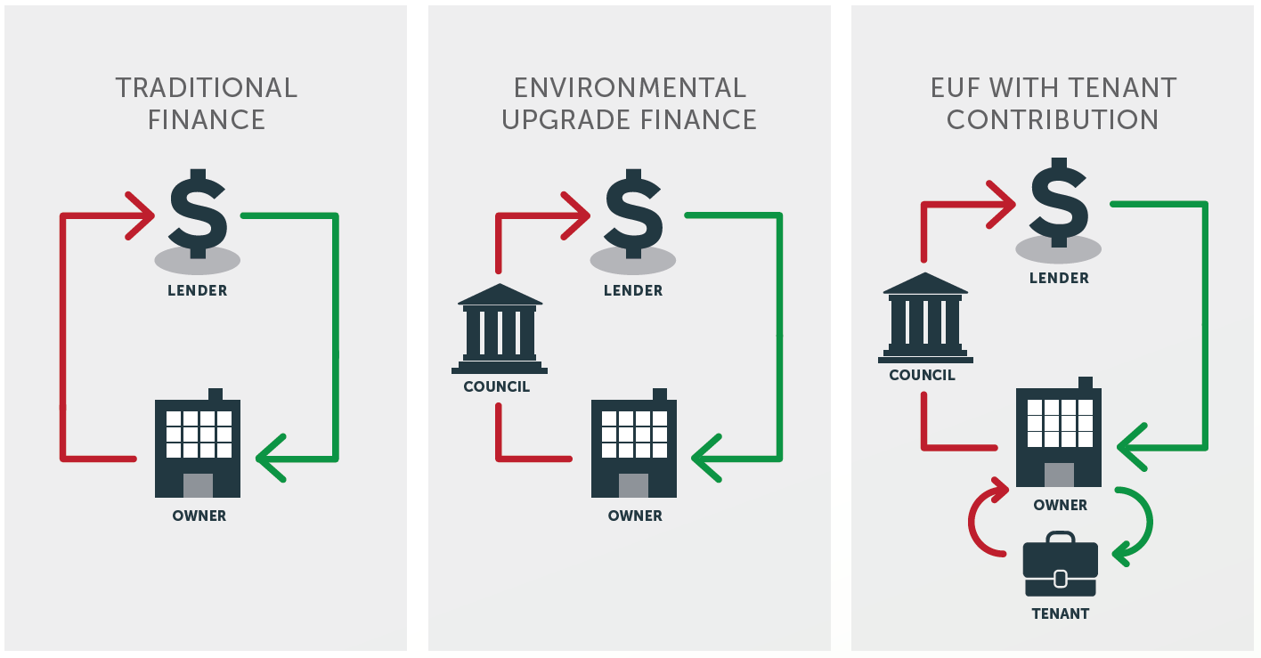
HOW DOES IT WORK?
Environmental Upgrade Finance is a
loan repaid via fixed council rates
100% finance for your project – additional capital for your business to grow
Loans between $15k and $20M
Terms up to 20 years – enabling positive cashflow
Finance attached to the property until repaid, is not retained by original owner if land sold
Rate payments may be recoverable outgoings
Finance for projects that deliver positive environmental outcomes:
  Renewable energy and batteries
  Water, waste and energy efficiency

Slide 4



OUR FINANCE
A product for all businesses seeking capital and cashflow benefits
A new way to finance environmental upgrades as part of significant renovation and repositioning projects
A fixed rate, long term solar PV & battery finance solution for commercial installations, bringing power into your own hands
A flexible, long term loan for innovative environmental upgrade projects, including energy efficiency, waste management, water, retrofits and more

Slide 5
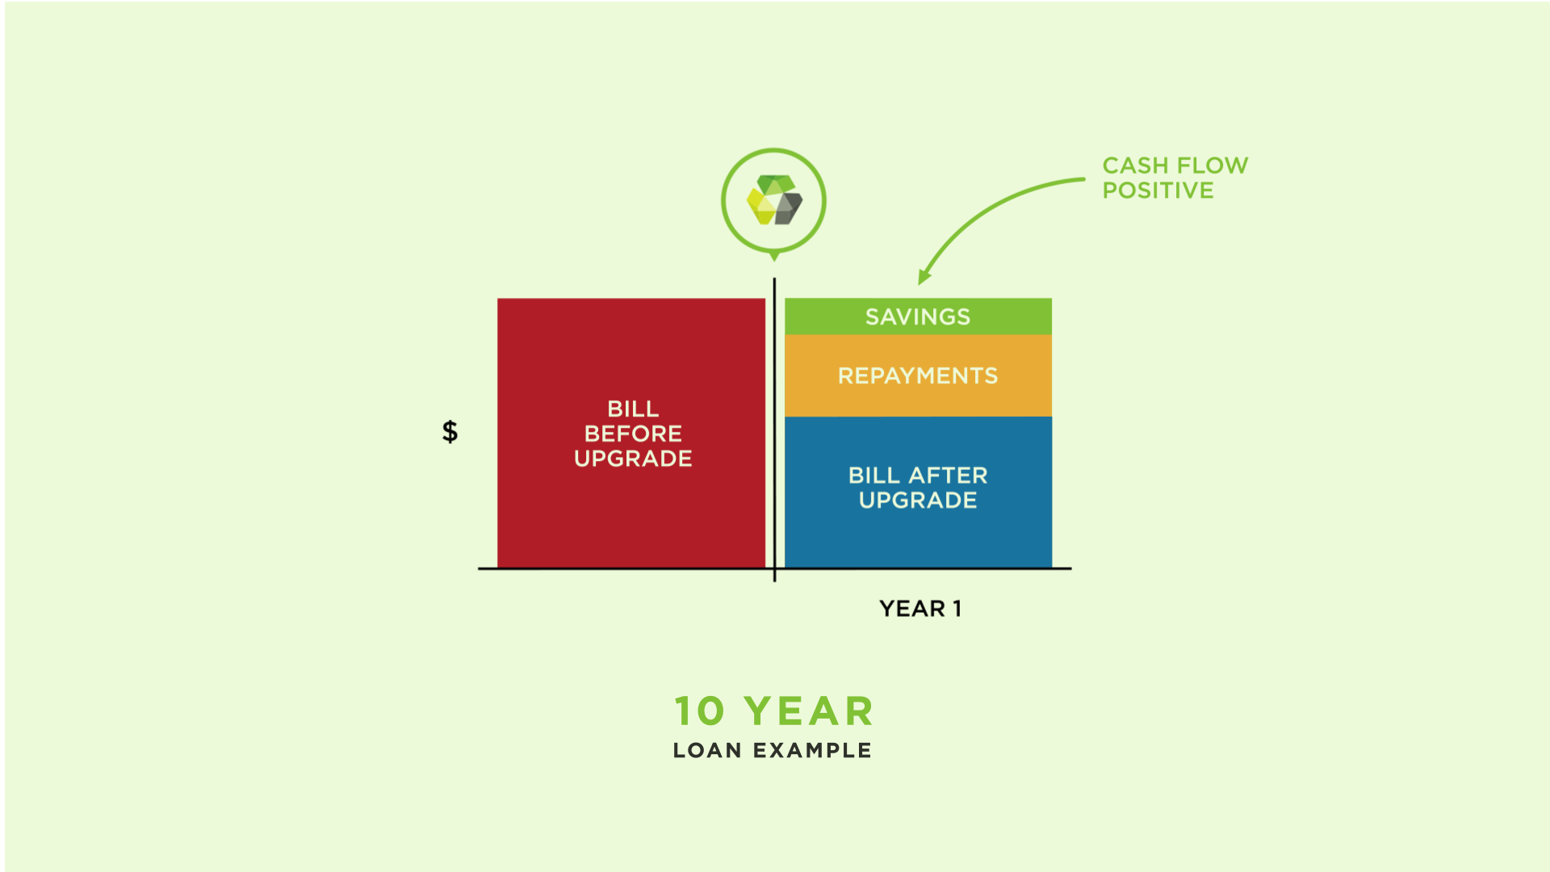
Fixed quarterly repayments to local council
Loan terms of up to 20 years to maximise cashflow
Loan tied to building, not owner
No deposit
No additional personal security required

Slide 6
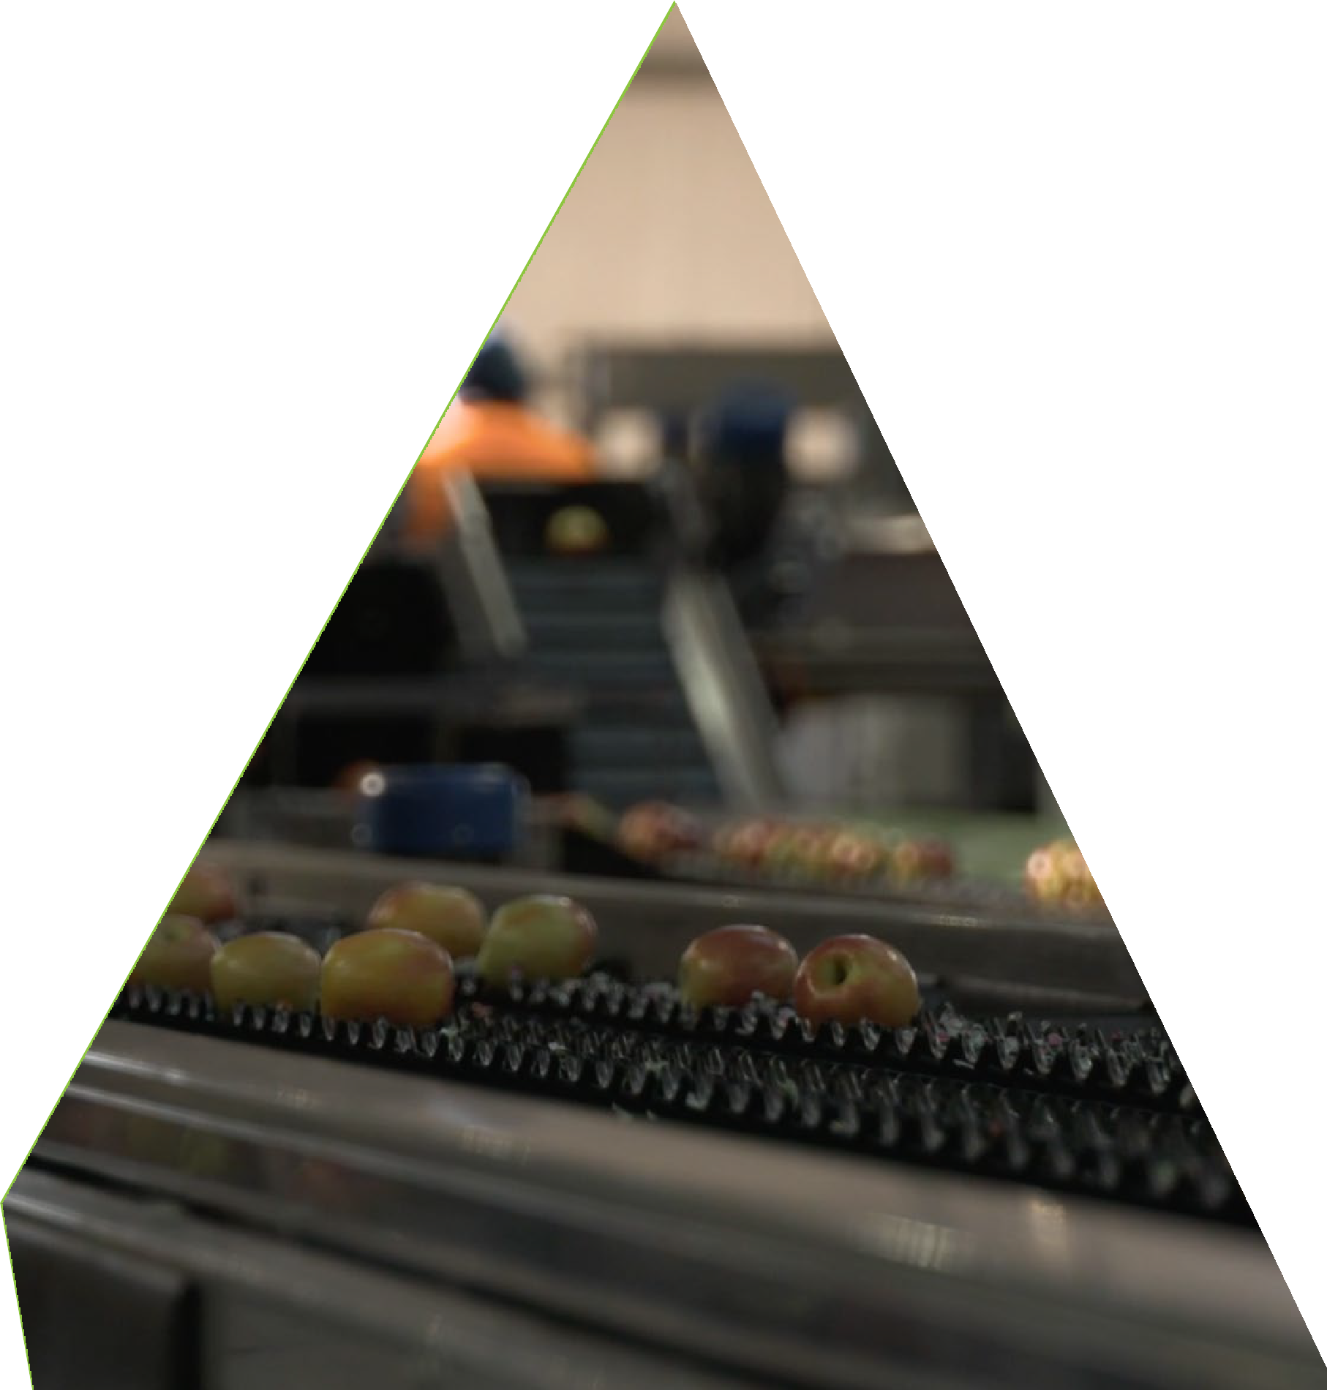
Solar, water and auxiliary upgrades
Loan terms of up to 20 years to maximise cashflow
Loan tied to building, not owner
No deposit or additional personal security required

Slide 7
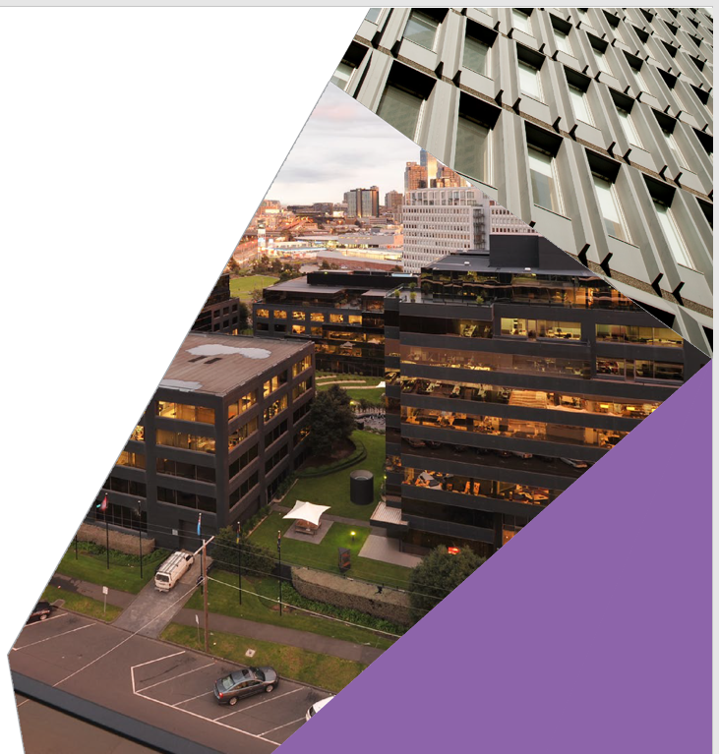
Replace expensive debt or equity
Decrease financial risk
Loan terms of up to 20 years
Improve environmental outcomes
No repayment up to two years

Slide 8
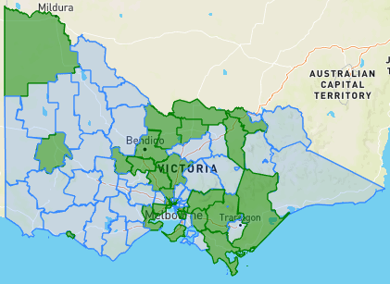
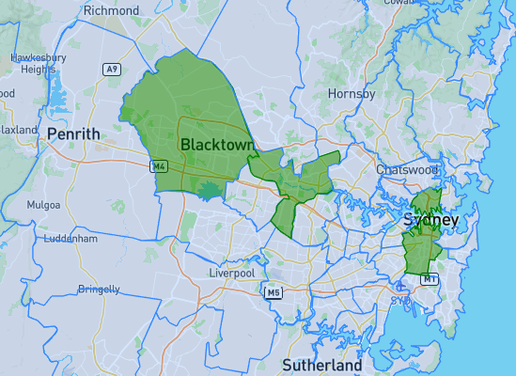
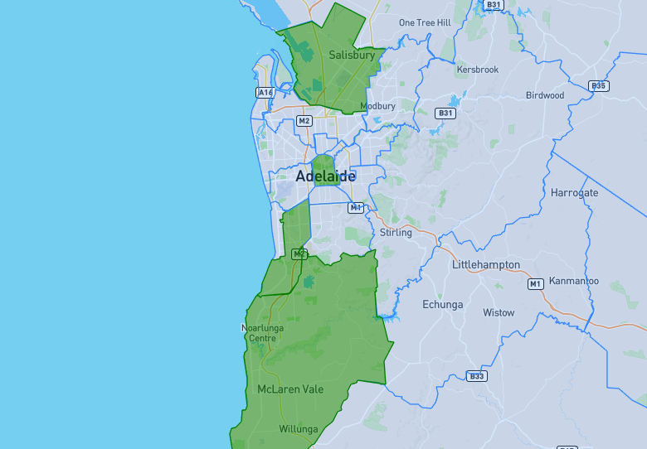
COUNCIL PARTNERS
Victoria
35 Councils (78)
NSW
6 Councils (128)
SA
6 Councils (73)

Slide 9
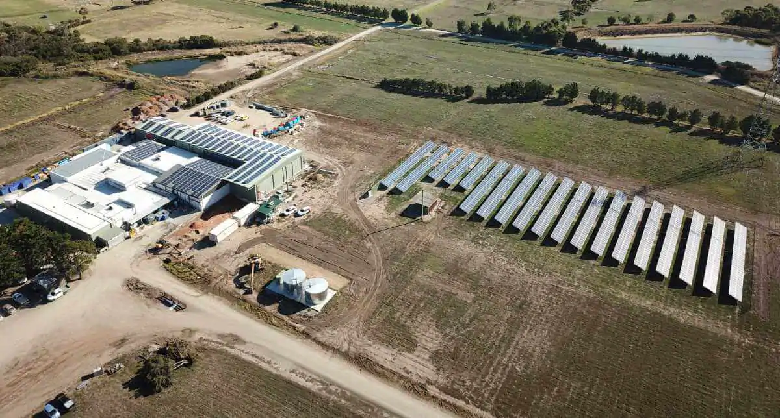
CASE STUDY
Hussey & Co
Council Partner
Mornington Peninsula Shire Cherry Energy Solutions
Project Overview
Hussey & Co is a lettuce farm. With 74 acres & multiple industrial processing facilities, it relies heavily on energy to stay in business.
Upgrade details
After initially installing a roof-mounted system and realising the savings, Hussey & Co decided to take out another EUA almost immediately for a ground-mounted system.
Stage 1: 99.64kW system
Stage 2: 505kW system
Total: 887kW total solar PV array
Outcome
$86,000 saved per year
754 tonnes of carbon emissions abated
“EUF has been a great way for our business to simply access finance with a favourable rate and term.”
Lance Peterson, General Manager

Slide 10
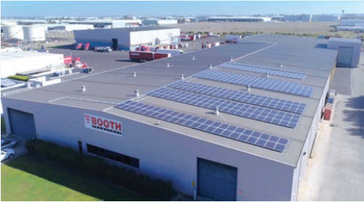
CASE STUDY
Booth Transport
Council Partner
Wyndham City Council Cherry Energy Solutions
Project overview
One of Australia's most respected freight and logistics providers. The company has been around for 80 years and its operations expand across five states with 600 employees and approximately 300 trucks. They chose solar to save on energy bills so they can invest in other parts of the business.
Upgrade details
99.75 kW system was installed in Laverton and a 391.02 kW system in Strathmerton.
100kWh Tesla Powerpack installed in Strathmerton
2 x EUAs over 10 years
Outcome
$141,250 annual savings in energy bills
Cashflow positive from day one
“Repayments were attractive as they come in the council rates once a quarter rather than every month so it make it a lot more manageable servicing than a normal loan.”
Mitchell Booth, Managing Director

Slide 11
Thank You
James Wark
Head of Commercial Sales
Sustainable Australia Fund
james@saf.finance
www.sustainableaustraliafund.com.au

