Slide 1
SOLAR + BATTERIES for RESIDENTIAL APPLICATIONS

Slide 2
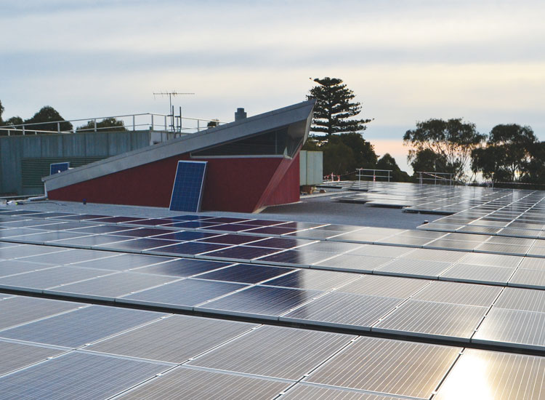
SOLAR for BUSINESS
1 of 3 Monash sites
Produces 170 MWh a year
Fully constructed in 30 days (holiday period)
Loss management - Shading issues
Several case studies today
Monash University, Frankston 135kW

Slide 3
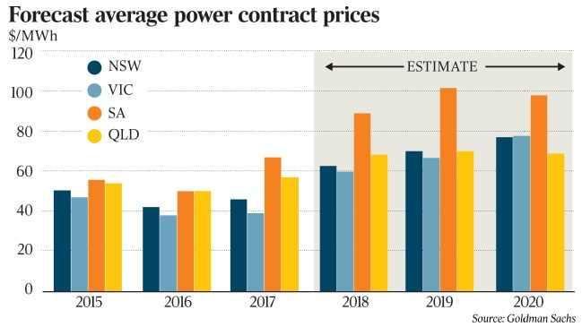
ENERGY PRICES CONTINUE TO RISE

Slide 4
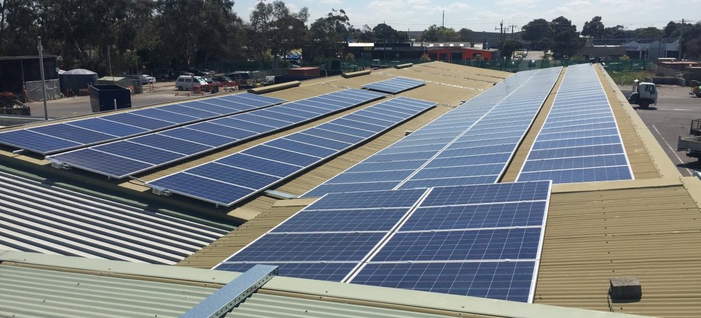
WHO IS ENVIROGROUP ?
Approved Partner – City of Port Philip
15 years of Installations – CEO/Owner Mick Harris
CEC Approved Retailer (2014) and 2015 Best Installation Winner
Over 400+ Commercial Installations - Council and Commercial Buildings
Frankston City Council, 95.5kW

Slide 5
Generate 90% of daily usage
26 days
Burder Industries, 355kW

Slide 6
SOLAR POWER – GRID CONNECTED

Slide 8
Melbourne ShowGrounds, 80kW
Why Install Solar?
Electrical Security - Protect business against price increases (25+years)
Reduce Operating Costs
Improve Cash-Flow
Payoff Asset - instead of paying an Energy Retailer
Depreciation tax offset
Reduced Carbon Footprint
Sustainable Image of Business
Melbourne Showgrounds, Ascot Vale
Wanted maximum yield from roof top
Air con caused shading which limited options
Client preferred enhanced safety and monitoring
MICRO INVERTERS

Slide 9
Feasibility Study
Determined by:
Energy Consumption
Energy Rates
Daily Electrical Load Analysis
Roof Space – limitations
Product Selection
Investment Strategy
Hero Apartments
Hero Apartments, 50kW

Slide 10
Case Study:
Craig Care Retirement Village
.216315c/kWh

Slide 11
Case Study:
Craig Care Retirement Village

Slide 12
Case Study:
Craig Care Retirement Village

Slide 13
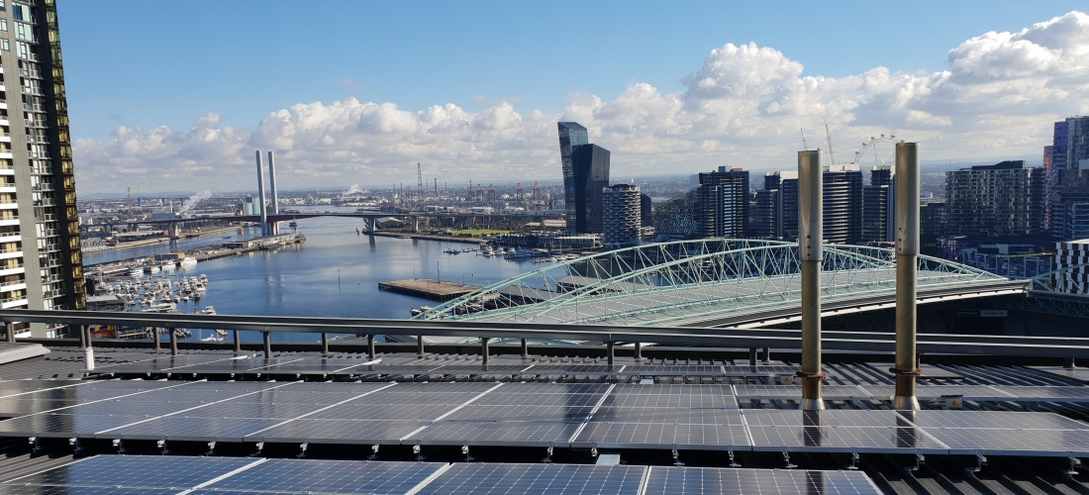
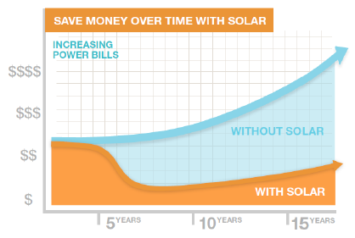
How to Finance a Solar System:
Pay Upfront
Immediate savings to P&L
Business Asset
Invest in cost saving solutions whilst trading conditions are good
* Depreciated Item.
Hero Apartments
AMP Capital, 150kW

Slide 14
How to Finance a Solar System:
Low Interest Loan
No capital outlay required upfront
Immediate Business Asset
Pay off system over 5-6 years
End up with an asset
AMP Capital, 150kW

Slide 15
How to Finance a Solar System:
Operating Lease
No capital outlay required upfront
Pay off system over 5-6 years
Improve cash-flow – Savings versus paying elect bill
End up with an asset
Secured only against the Asset
* Talk to your accountant about tax savings
AMP Capital, 150kW

Slide 16
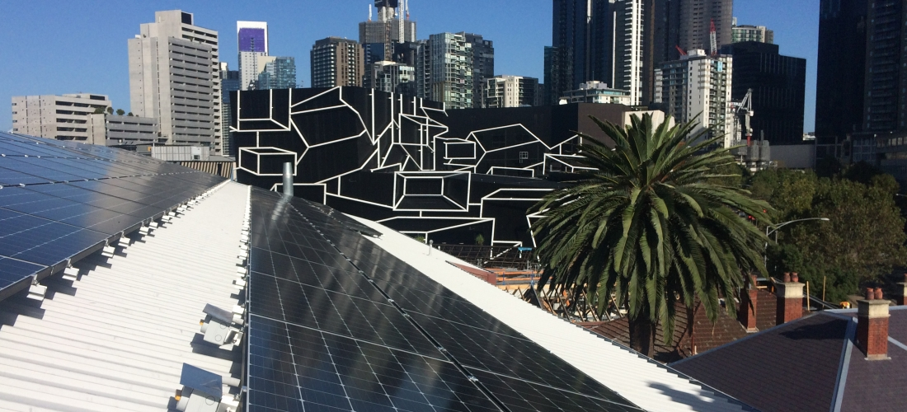
Feasibility Study – e. Reahan.martin@envirogroup.com.au
m. 0410 023 160

