Slide 1
Module 2
Management

Slide 2
The manager’s role
Allergies are a big risk for any food business and strong management is a huge contributing factor to mitigating that risk.
Management of allergens comes in many forms including:
Knowing what allergens your business deals with.
Creating processes and plans to ensure allergens are appropriately handled and cross-contamination is avoided.
Effectively communicating about allergens with your customers.
Hiring the right staff and providing them with relevant information to avoid any unnecessary incidents.
Encouraging staff to be vigilant of allergy risks and to report any unsafe or uncompliant behaviours immediately.

Slide 3
Track your progress
Module 1: Introduction
Module 2: Management (You’re here 📍)
Module 3: Training
Module 4: Front-of-house
Module 5: Suppliers
Module 6: Storage
Module 7: Preparing, handling and serving
Module 8: Labelling

Slide 4
Getting to know your business' allergens
Food businesses have a legal obligation to provide information to consumers about the allergens that are in their foods.
By law you and your staff need to know whether your food includes any of the following 23 allergens or their products:
Wheat
Fish
Crustaceans
Mollusc
Eggs
Milk
Lupin
peanut
Soy, soya, soybean
Sesame
Almond
Brazil nut

Slide 5
Getting to know your business' allergens
Cashew
Hazelnut
Macadamia
Pecan
Pistachio
Pine nut
Walnut
Barley*
Oats*
Rye*
Sulphites**
* Barley, oats and rye must be declared if they contain gluten.
** Sulphites must be declared when added in amounts equal to or more than 10 milligrams per kilogram of food.

Slide 6
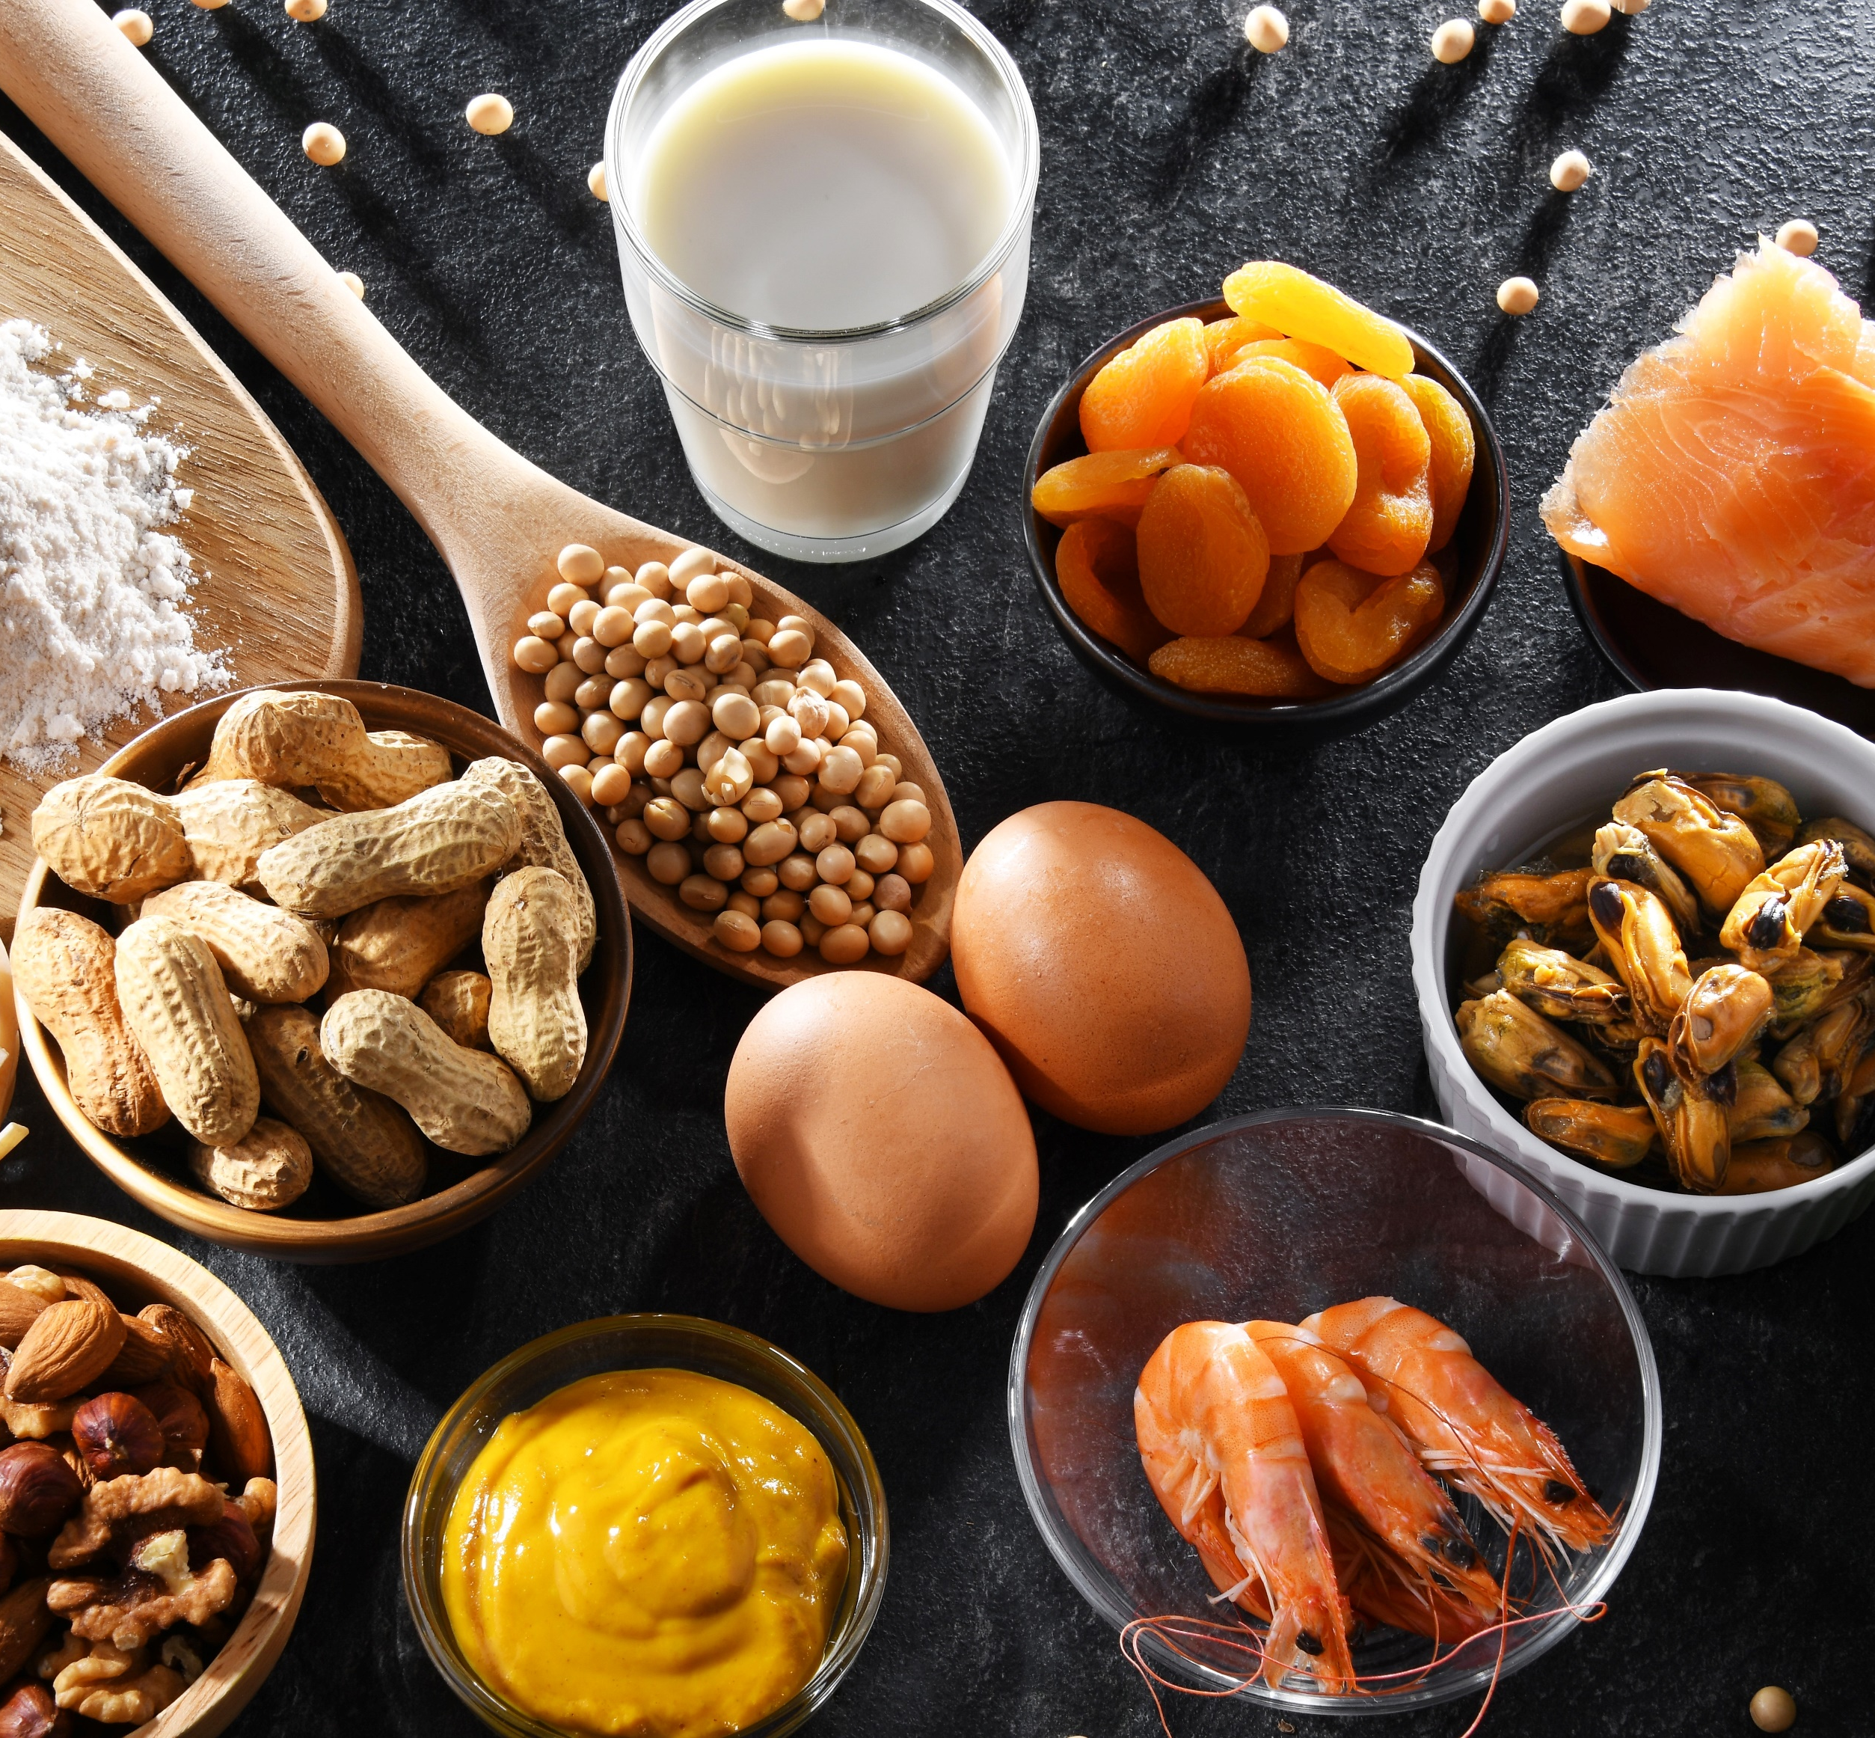
Creating processes and plans to manage allergens
Some common processes and plans for managing allergens within a food business includes:
Contacting suppliers to check they are labeling their products correctly and that the products don’t contain any unidentified allergens.
Training staff on how to appropriately store, prepare, handle and serve food that contains common allergens.
Effectively communicating what foods contain which allergens. This can be done with notes on menus, allergen matrices and verbally through staff.
Creating a contingency plan for what to do in the unforeseen event that an incident was to occur. For example, having a first aid kit, first aid trained staff or a list of emergency contacts.
Having strong investigative and reporting processes in place for after an incident.

Slide 7
Controlling allergens
Know the 23 specified allergens and whether they are in the foods you sell.
Check ingredients information and labels and record them in an allergen matrix.
Ensure foods containing the 23 specified allergens are correctly stored (reviewed more in Module 5 and 6).
Keep a record of how you store things and relay that information to staff through training.
Educate staff about the risks that allergens pose to customers.
Provide training and resources and ensure staff know how to ask about and deal with allergens.
Have clear communication with customers about allergens.
Use notice boards to advise customers to talk with staff and include ingredient information on menus and your website where possible.
Have set processes and recipes and ensure staff stick to them.
Relay the importance of not changing recipes without advising the manager and front-of-house staff.
Remove allergens where possible.
Identify changes you could make to reduce the number of allergens contained in your food and on your premises.

Slide 8
Communicating allergen information to customers
Effective communication is a significant part of managing allergens on a day-to-day basis.
The management team needs to be able to effectively communicate with staff about the importance of being allergen-safe.
Staff also need to feel comfortable communicating with each other about how to avoid incidents and other best practice.
And lastly, staff need to feel confident in relaying allergen information to customers.
Allergen information is mostly communicated through:
menus
chalk boards
order tickets
product labels
verbally.

Slide 9
Communicating allergen information to customers
If the information is to be provided verbally by a member of staff, then it is necessary to make it clear that the information can be obtained by asking a member of staff.
An example of suitable wording would include:
Food Allergies and intolerances: Please ask a member of staff if you require information on the ingredients in the food we serve.
It is no longer acceptable for businesses to say that they do not know whether a food contains an allergen, nor is it enough to say that all their foods may contain allergens. Allergen information must be specific to the food, complete and accurate.

Slide 10
Putting the customer first
If a customer confides to you or your staff that they have a food allergy, you should always put their needs first by:
Confirming what ingredients are in the dish they have ordered
You can do this by:
Checking the ingredient lists of all packaged foods and speaking to any suppliers of un-packaged foods.
Checking your allergen matrix or recipe cards.
Checking the most up-to-date saved labels from utilised products.
Checking with kitchen staff.
Ensuring their food is handled and delivered correctly
You can do this by:
Using appropriate hygiene controls.
Storing the foods correctly.
Handling the foods with the necessary utensils and washing them before using.
Checking with other staff members involved in the preparation of the menu item (For example, kitchen staff) to ensure that no allergens were used, and the correct processes were followed.

Slide 11
Case study – misinformed manager
Note: This is a real-life incident that occurred in the City of Port Phillip.
A function centre was holding a ‘menu tasting’ for customers who had booked events.
A customer who attended with family has a severe nut allergy. They had advised the event manager about the allergy in advance and were eager to try as many dishes as they could.
During the tasting the customer wanted to try a vegan quiche that had been served to another family member. They checked with the event manager to see if the vegan quiche contained nuts. The manager stated, “No, there shouldn’t be”. The customer then decided to have a taste of the dish.
After a few minutes, the customer started to have symptoms of anaphylaxis. The manager returned to the group to apologise and explain that the chef had just informed them the quiche contains a vegan cheese made from cashews.
After an Epi-Pen was administered, the customer was taken to hospital by ambulance. Thankfully, the customer made a full recovery. ​

Slide 12
Case study – Let's take a moment to reflect on this case
What actions could the business have taken to prevent this incident from occurring?
Was the event manager suitably trained in allergy and anaphylaxis?
Do you think the event manager double checked the request with the kitchen before responding to the customer?
What impact could this incident have on the business?
Could something like this happen in your business? If not, why not?

Slide 13
Case study - How could this incident have been avoided?
The event manager should have completed food allergen training before undertaking their role.
The manager should have advised the customer that they were unsure and double checked with the chef before allowing them to consume the quiche.
The manager and chef could have worked together before the event to identify which items contained allergens and which did not.
The manager should have checked any available allergen-related documents. For example, a food matrix,.
Can you think of anything else?

Slide 14
Resources – Food Allergen Menu Matrix
A Food Allergen Menu Matrix is a chart that lists all current menu items for a food business and then identifies which common food allergens are contained within the menu item or could affect the item through cross-contamination.
A comprehensive allergen matrix can take time to create and needs to be updated regularly as recipes and products change.
However, having an allergen matrix ensures that there is a set place that all staff can go to confirm and track allergen risks.
As you can see from this module, allergen matrices are a key part of controlling food allergens.
It’s therefore recommended that all food businesses create and keep a matrix.
We have provided you with an allergen matrix template to assist you with this task.
Download a food allergen menu matrix HERE

Slide 15
Resources – Recipe Reports
A Recipe Report is a table template that can be used to keep track of all ingredients and potential allergens within a food recipe or product.
These can be used to keep track of allergens with both:
In-house recipes – you should complete this every time you create or update a recipe or menu item within your business.
External products – you should complete one of these for each of the products you purchase externally. You should be able to get most of the key information from the product label or directly from the supplier.
Creating a comprehensive set of reports can take time and will need to be updated regularly as recipes and products change.
However, having a folder of reports alongside an allergen matrix ensures that there is one set place that staff can go to confirm allergen risks.
We have provided two Recipe Report templates for you and a link to more.
Download the standard Recipe Report template HERE
Download the bulk Recipe Report template HERE
Find more Recipe Report templates HERE

Slide 16
This week’s activities and what comes next
Each week we’ll ask you to reflect on and implement what you have learnt.
This week we ask that you:
Familiarise yourself with the 23 allergens and their products.
Create a Food Allergen Menu Matrix and some Recipe Reports for your business.
Complete Module 2 Workbook: Management.
Download Module 2 Workbook HERE
Take this week’s test.
Take the Module 2 Test HERE
Next week
In our next module (Module 3), we will be looking at the differences that allergen training can have on your business.

Slide 17
If you have any question or would like some additional guidance, please contact your Environmental Health Officer.

