Slide 1
Module 8
Labelling

Slide 2
Track your progress
Module 1: Introduction
Module 2: Management
Module 3: Training
Module 4: Front-of-house
Module 5: Suppliers
Module 6: Storage
Module 7: Preparing, handling and serving
Module 8: Labelling (You’re here 📍)

Slide 3
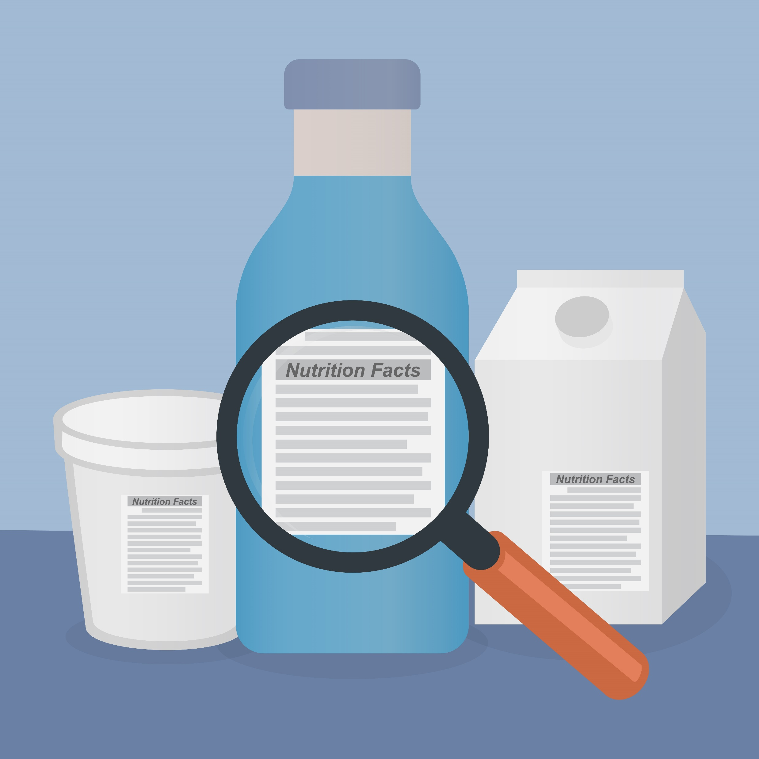
Why labelling your food is important
Food labels are important because they display a range of useful information about packaged food products, including:
ingredients lists
certain allergens
used-by dates
instructions for storage and preparation
advisory and warning statements.
Ensuring the packaged foods you purchase or produce have labels, helps insure you and others have access to this vital information.
This information is so important, that it is even recommended that you keep labels whenever you decant the product from the packaging. So, that you have access to that information whenever you need.
A useful way to record these labels is with an allergen matrix (see Module 2) or label folder.

Slide 4
Information that must be declared on labels
The regulations (Australia New Zealand Food Standards Code) requires certain information to be declared on labels, including:
ingredients
ingredients of compound ingredients
food additives or components of food additives
processing aids or components of processing aids.
Labels also need to clearly identify whether any of the 23 food allergens (as described in Module 2) are present within the product by name.
Including this information on the label ensures that people who may be negatively affected by them or the allergens they may produce, are aware they are there.
If you label your own products, then you must check whether your food labelling is compliant by submitting it for NATA accredited laboratory testing.

Slide 5
Case study – please donut give me nuts
Note: This is a real-life incident that occurred in the City of Port Phillip.
The customer was buying some cakes for their children and requested further information from the shop assistant regarding the ingredients in the products. The customer mentioned to the shop assistant that one of their children had an allergy to nuts. There was no labels on the cakes and the shop assistant couldn’t produce a list of ingredients. The shop assistant eventually contacted their boss and then advised the customer that the cupcake and donut that they were interested in were nut-free.
The customer purchased the products and headed home, giving the chocolate doughnut to their daughter and the cupcake to their son who has an allergy to nuts. Both children consumed the cakes but unfortunately the boy also sampled some of the chocolate doughnut by licking its wrapper.
Within minutes the boy was having an anaphylactic reaction requiring immediate medical attention including an Epi-Pen and hospitalisation. Thankfully, the child had a full recovery.
Upon investigation, it was identified that the product was not a chocolate doughnut, but a Nutella doughnut and the product’s ingredients had recently been changed.

Slide 6
Case study - Take a moment to reflect on this case
What actions could this business have taken to prevent this incident from happening?
Was the customer adequately informed of the products when requested?
Were the cakes stored and handled to prevent cross-contamination?
Were the cakes packaged separately or together for takeaway?
Could something like this happen to your business? If not, why not?

Slide 7
Case study - How could this incident have been avoided?
Training would have helped staff understand how important providing accurate information about allergens is.
Ensuring product information and labels are available, even after food has been decanted or displayed. This can be done with an allergen matrix (see Module 2)
If the staff member or manager weren't sure about whether the food contained potential allergens, then they should have made this clear.
Labels and product information should have been reviewed regularly to ensure that recipes and allergen contents didn’t changes.
Can you think of anything else?

Slide 8
This week’s activities and what comes next
Each week we’ll ask you to reflect on and implement what you have learnt.
This week we ask that you:
Audit your food labels to ensure that they are accurate and compliant with the Australia New Zealand Food Standards Code.
Complete Workbook 7: Labelling.
Download Module 8 Workbook HERE
Take this week’s test.
Take the Module 8 Test HERE

Slide 9
🎉 Congratulations 🎉
This brings us to the end of our food allergen modules, thank you for joining us. If you completed all the necessary readings, workbooks and tests, then you have now graduated from this course.
Following this course, you should feel more confident in identifying and controlling allergens within your business through education and action planning.
Remember strong allergen management filters from the top down. If you do not make it a priority, then no one will. This leaves your customers and business at risk.
Before you go, we would love to hear your feedback about the training modules. You can send it to us at: grainne.osullivan@portphillip.vic.gov.au
For further information refer to The Food Allergens Portal or ask your Environmental Health Officer.

Slide 10
If you have any question or would like some additional guidance, please contact your Environmental Health Officer.

