Slide 1
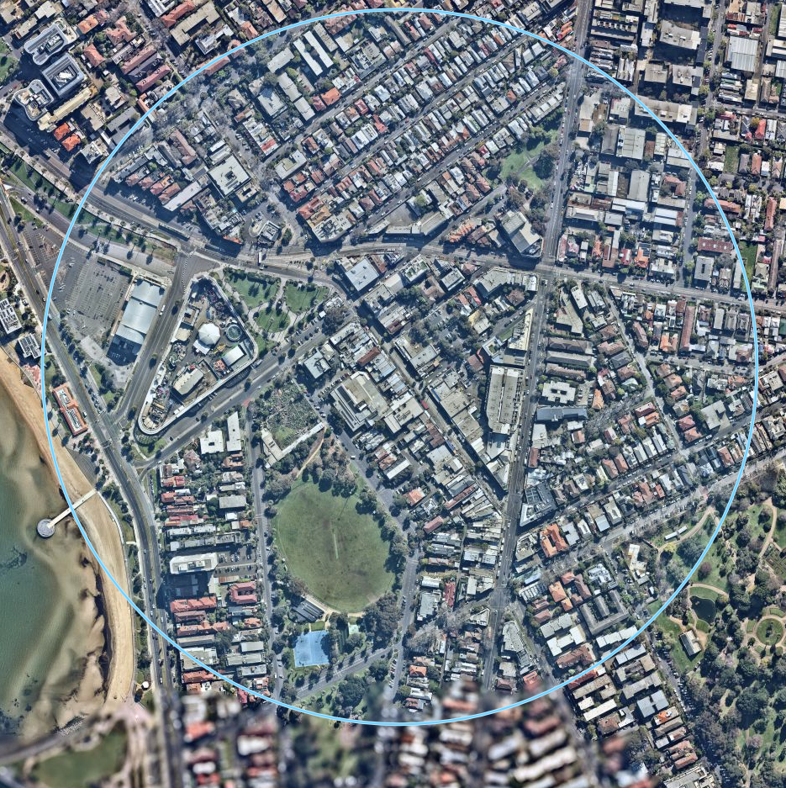
Carparks in Acland Street Precinct
Council-managed carpark
Privately-managed carpark
1
St Kilda Triangle Carpark
338 spaces
400m radius
2
Shakespeare Grove Carpark
129 spaces
3
Chaucer Street Carpark
30 spaces
4
Woolworths Arcade Carpark
84 spaces
1
5
5
Irwell Street Carpark
20 spaces
6
2
3
6
Belford Street West Carpark
79 spaces
4
7
8
7
Belford Street Carpark
33 spaces
8
Acland Court Carpark
176 spaces
This data does not include private business carparks, such as the McDonald’s carpark, or private residential carparks.
In 2016, Council noted there were ‘over 1,900 on-street parking spaces within a 5-minute walk (400m)’ of Acland Street. When combined with the figures above, this produces a total of more than 2,789 spaces in a 400m radius.

Slide 2
Public Transport in Acland Street Precinct
Frequency (‘every X mins’)
Weekdays |  | Saturday |  | Sunday
Highest | Lowest | Highest | Lowest | Highest | Lowest
6 | 20 | 10 | 30 | 10 | 30
9 | 20 | 12 | 22 | 12 | 31
n/a | x | 12 | 21 | 12 | 30
10 | 20 | 15 | 30 | 15 | 30
10 | 38 | 12 | 40 | 27 | 46
36 | 45 | 60 | 60 | 60 | 60
15 | 60 | 60 | 72 | 60 | 72
400m radius
606
96
16
3a
623
Tram
16
3a
96
246
246
600 922
923
Bus
606
623
600/922/933

Slide 3
Bicycle Access in Acland Street Precinct
Bay Trail
Off-road path
Beaconsfield Parade / Jacka Boulevard / Marine Parade route
State Road – Strategic Cycling Corridor
400m radius
Fitzroy Street to Elwood Beach route
Council Streets – ITS Bicycle Corridor
Elwood to St Kilda Beach route
Council Streets – ITS Bicycle Corridor
\

