Slide 1

B Lab Australia & New Zealand
Better Business for a Better World

Slide 2
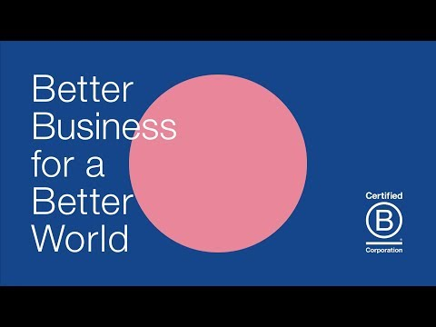
Hub Australia x B Lab ANZ
B Corp Month Lunch & Learn
Better Business for a Better World
Notes:
BCM intro video
BCM campaign: Better Business for a Better World - largest awareness raising campaign in ANZ for B Corp
Have already reached more than 500,000 on social media

Slide 3
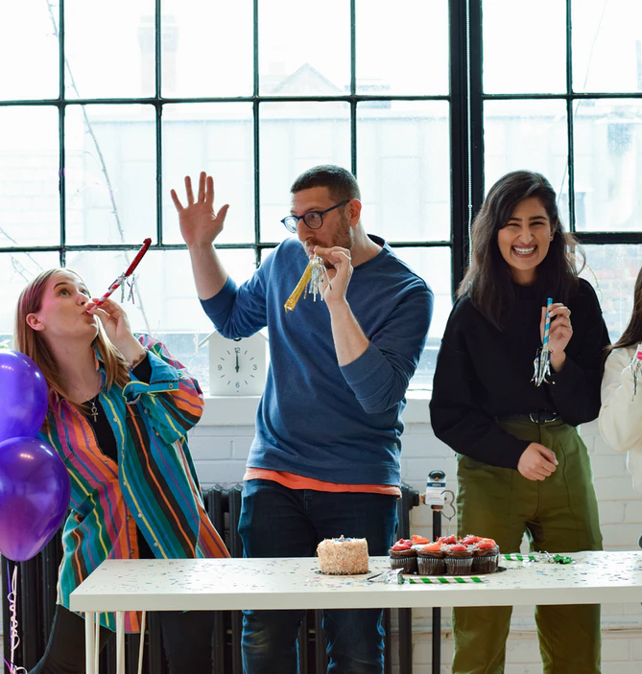

What is a B Corp
Certified B Corporations (B Corps) are for-profit companies that use the power of business to build a more inclusive and sustainable economy.
They meet the highest verified standards of social and environmental performance, transparency, and accountability.

Slide 4
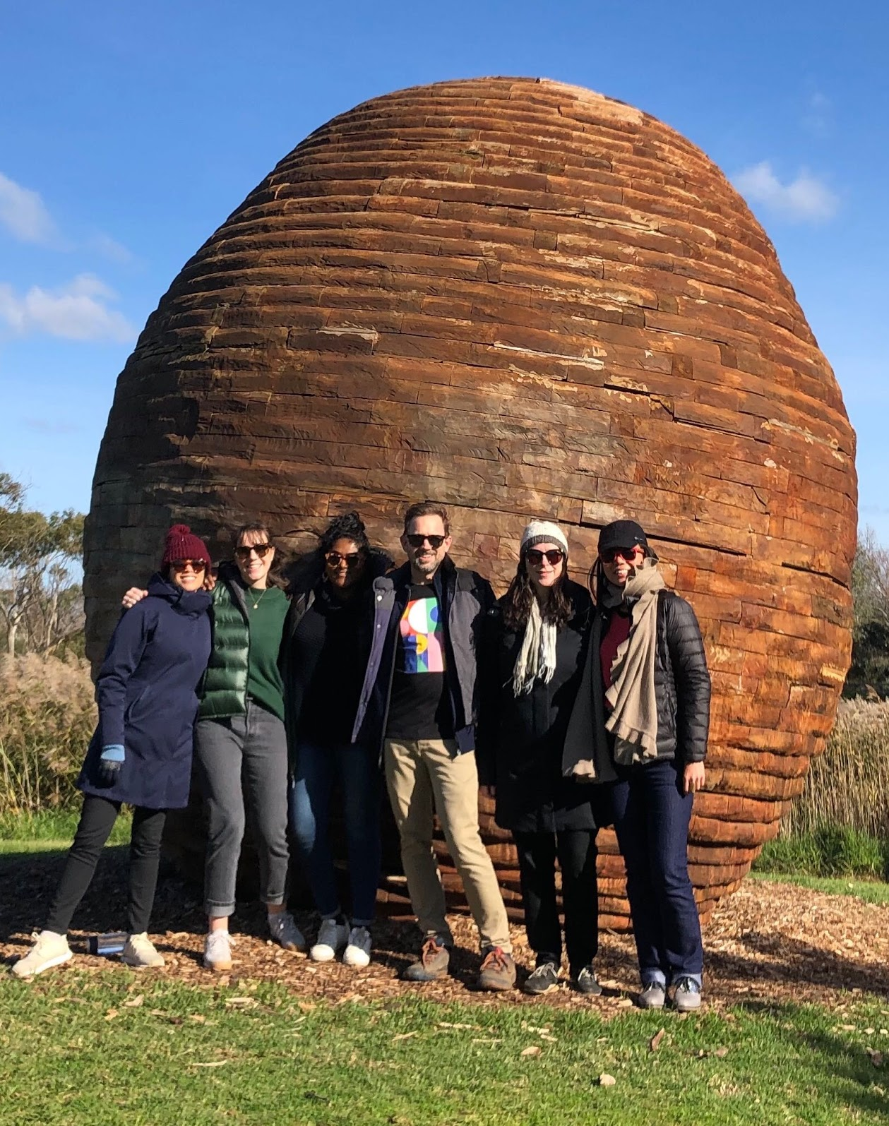
What is B Lab?
B Lab is a nonprofit that serves a global movement of people using business as a force for good™.
B Lab’s vision is that all people in Australia & Aotearoa New Zealand benefit from an economy that builds community and regenerates the environment.
Notes:
8 months at B Lab
Background in environment and sustainability
I believe that business has the power to change and improve the world we live
Small team 7 in Melb office - look after Aus&NZ region

Slide 5
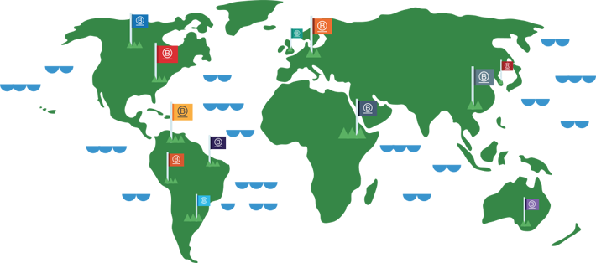
We are a global movement
B Lab Global (HQ USA) is the certifier and there are growing networks of B Lab’s globally.
Each B Lab is uniquely positioned to accelerate this culture shift and create a movement in its own market.
Notes:
Certification runs out of the USA
We in Australia and other B Lab’s around the world bring our regional companies in and help them navigate the process, once they submit their assessment the US team are the ones that verify the assessments then once they certify they come back to us and we welcome them into the community!

Slide 6
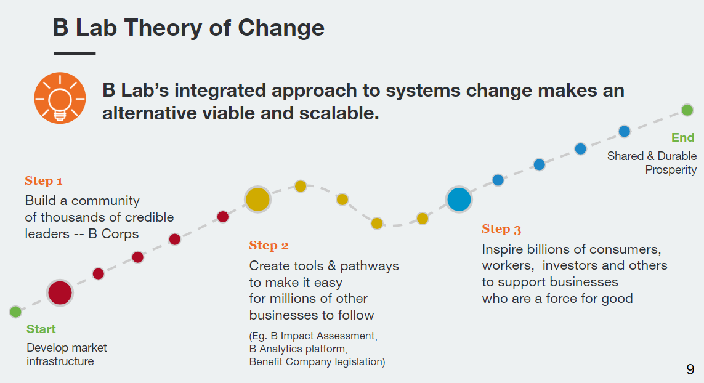
How are we going to create a just economy?

Slide 7
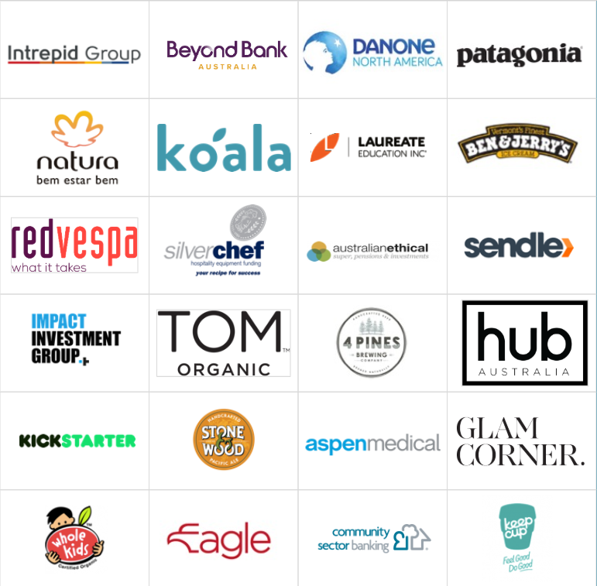
We are the company we keep
3,000+ Certified B Corps globally
160+ Industries
60+ Countries
1 Unifying goal: To redefine
success in business
Aus&NZ is the fastest growing region for B Corps with ~300 companies certified and 4,000+ companies taking the assessment.
Spot any B Corps you recognise?
Notes:
B Corps range from household brands to venture-backed disruptors to multi-billion dollar businesses. These are some of the B Corps -- from technology to textiles, energy to education, and food to finance -- that are leading the way as lighthouse businesses in their industries and regions.

Slide 8





How to become a B Corp
The B Impact Assessment (BIA)
The BIA is a free tool designed to help businesses holistically measure their performance and impact across 5 pillars; Governance, Community, Environment, Workers and Customers.
The BIA is an amazing framework for you to ensure you are operating responsibly.
Certified B Corporations achieve a minimum verified score of 80 on the B Impact Assessment.
COMMUNITY
CUSTOMERS
WORKERS
GOVERNANCE
ENVIRONMENT

Slide 9
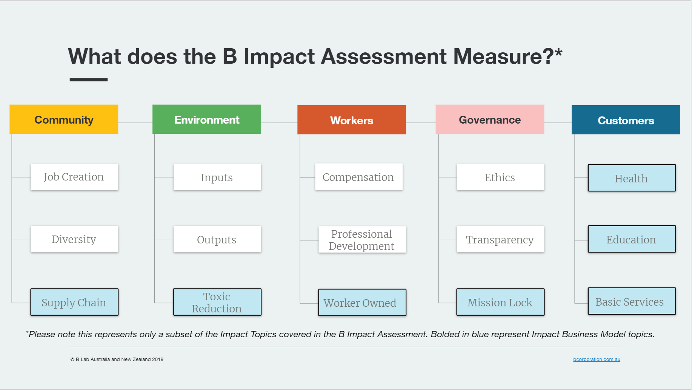
What does the BIA look at?
B Impact Assessment

Slide 10
Environment - 4 Pines Brewing Company
First certified in 2016: 97.9
Environment: 46.8
1 of 25 B Corp beers worldwide
Based in Manly, Sydney
Focus on energy efficiency
Divert over 95% of organic waste from landfills, across all 4 Pines sites
Eliminating all single use plastics from offices, venues, and supply chains
Reduce water useage re-use systems
Carbon offset all corporate travel and trade vehicles
Notes:
Have committed to purchasing 100% renewable electricity by 2022 or even sooner
Spent grain from the brewery is used for cattle feed or for baking dog treats. Spent yeast is turned into a renewable energy source.

Slide 11
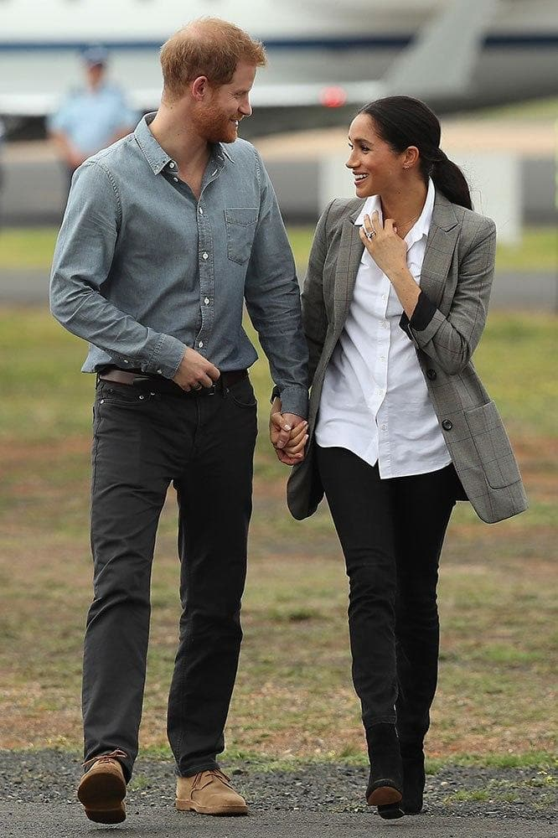
Community - Outland Denim
First certified in 2018: 111.5
Community: 51.8
Socially minded denim label that provides training and employment to victims of sexual exploitation in Cambodia
Proven that a sustainable career path is the key to true social change in not only the lives of their staff but their families and communities
Financial security, education and personal enrichment programs = FREEDOM
Clothing should not create poverty or exploit people; Outland Denim believes it can be a solution to some of the great social evils that exist in the world today
Notes:
Impact biz model: Workforce development

Slide 12
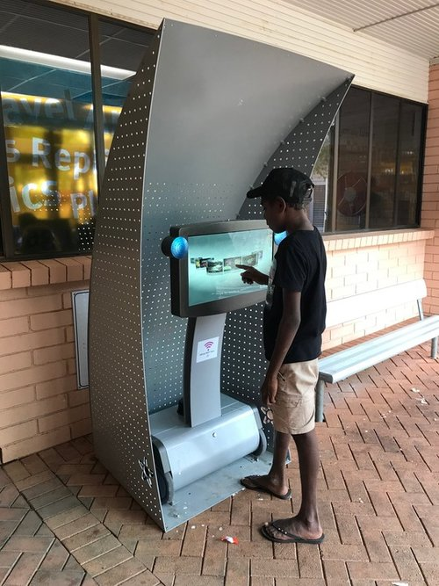
Customers - Hitnet
First certified in 2013: 110
Customers: 45.2
Hitnet brings information and services to the hardest to reach people in the world. In Australia, 2.5 million people don’t have access to the Internet.
Design Community Hubs to Wifi hotspots to enable people to connect to online services and access interactive health, social and cultural information in urban, regional and remote communities.
The Hubs are located in health clinics, hospitals, schools, libraries and youth detention centres.
Notes:
IBM: Health and wellness improvement
Arts, media and culture
Serving in needs population 30.1

Slide 13
Workers - Intrepid Travel
First certified in 2018: 82
Workers: 29.5
Had to do the BIA 23 times
First B Corps in Sri Lanka, Egypt and Cambodia
Introduced three weeks paid parental leave (or caregiver leave) for all staff – regardless of gender, which is a big deal in many countries.
Improving the gender balance in staff. For instance, our global leadership team has equal number of males and females in the three years since we applied for B Corp certification.

Slide 14
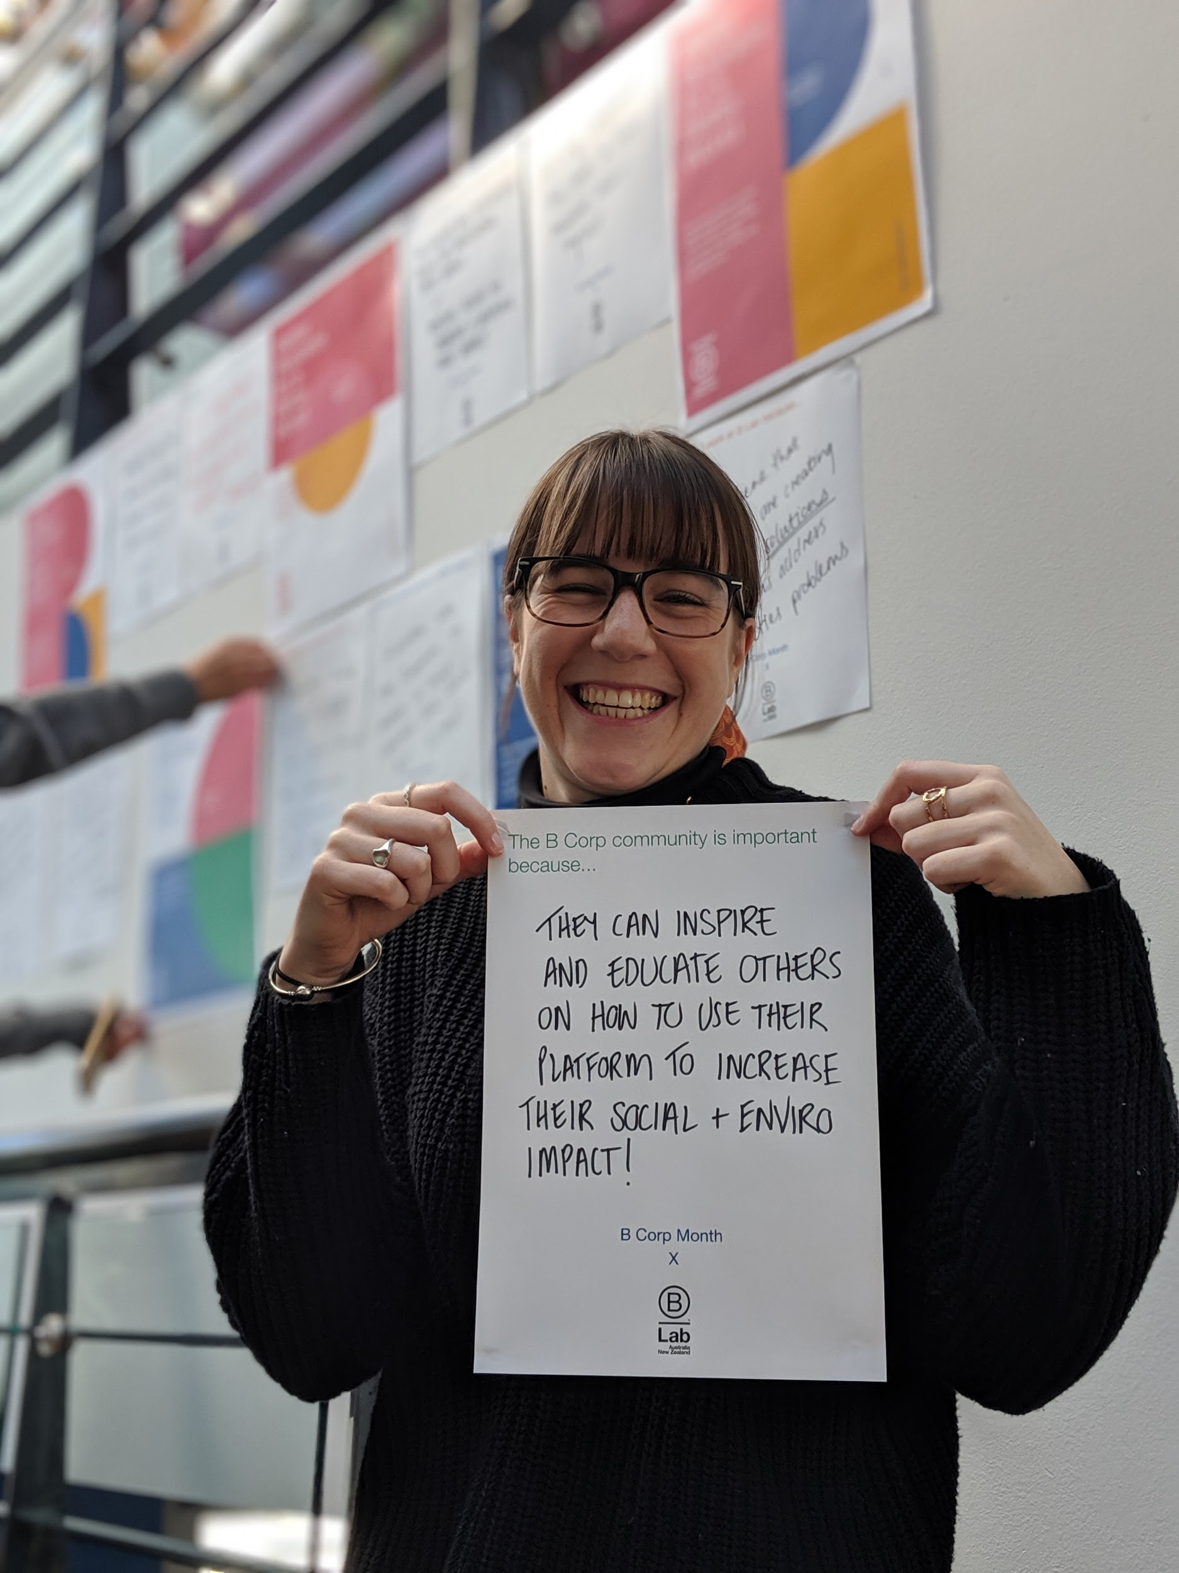
Why certify?
Differentiate from pretenders
Reconnect and articulate your core values
Benchmark performance
Find your tribe
Partner with peers around the world
Attract and retain talent

Slide 15
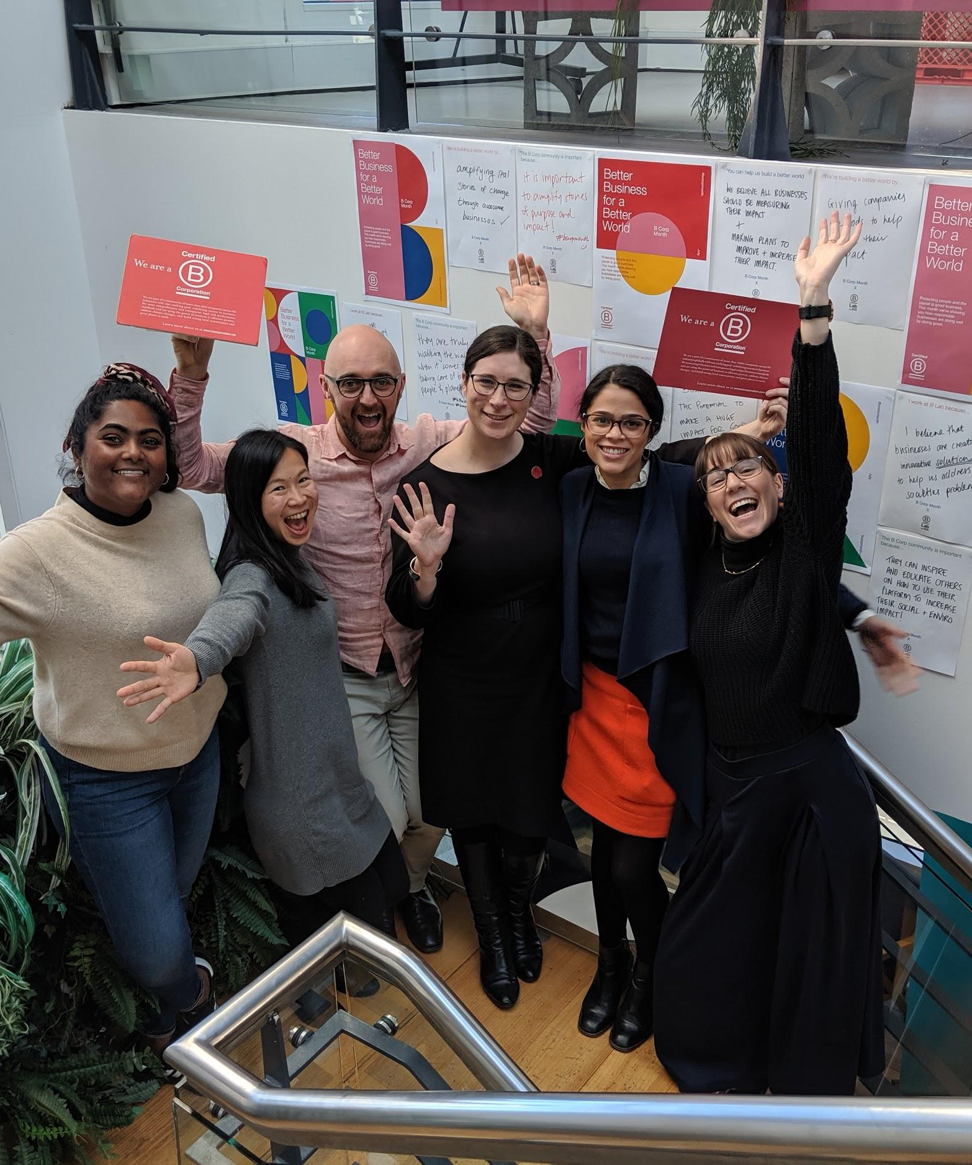
Who can certify?
For-profit businesses of any size
Any industry / geography
Customised assessment based on industry, size, geography
Any legal structure (except charities & non-profits with DGR status)
In operation for more than 1 year

Slide 16
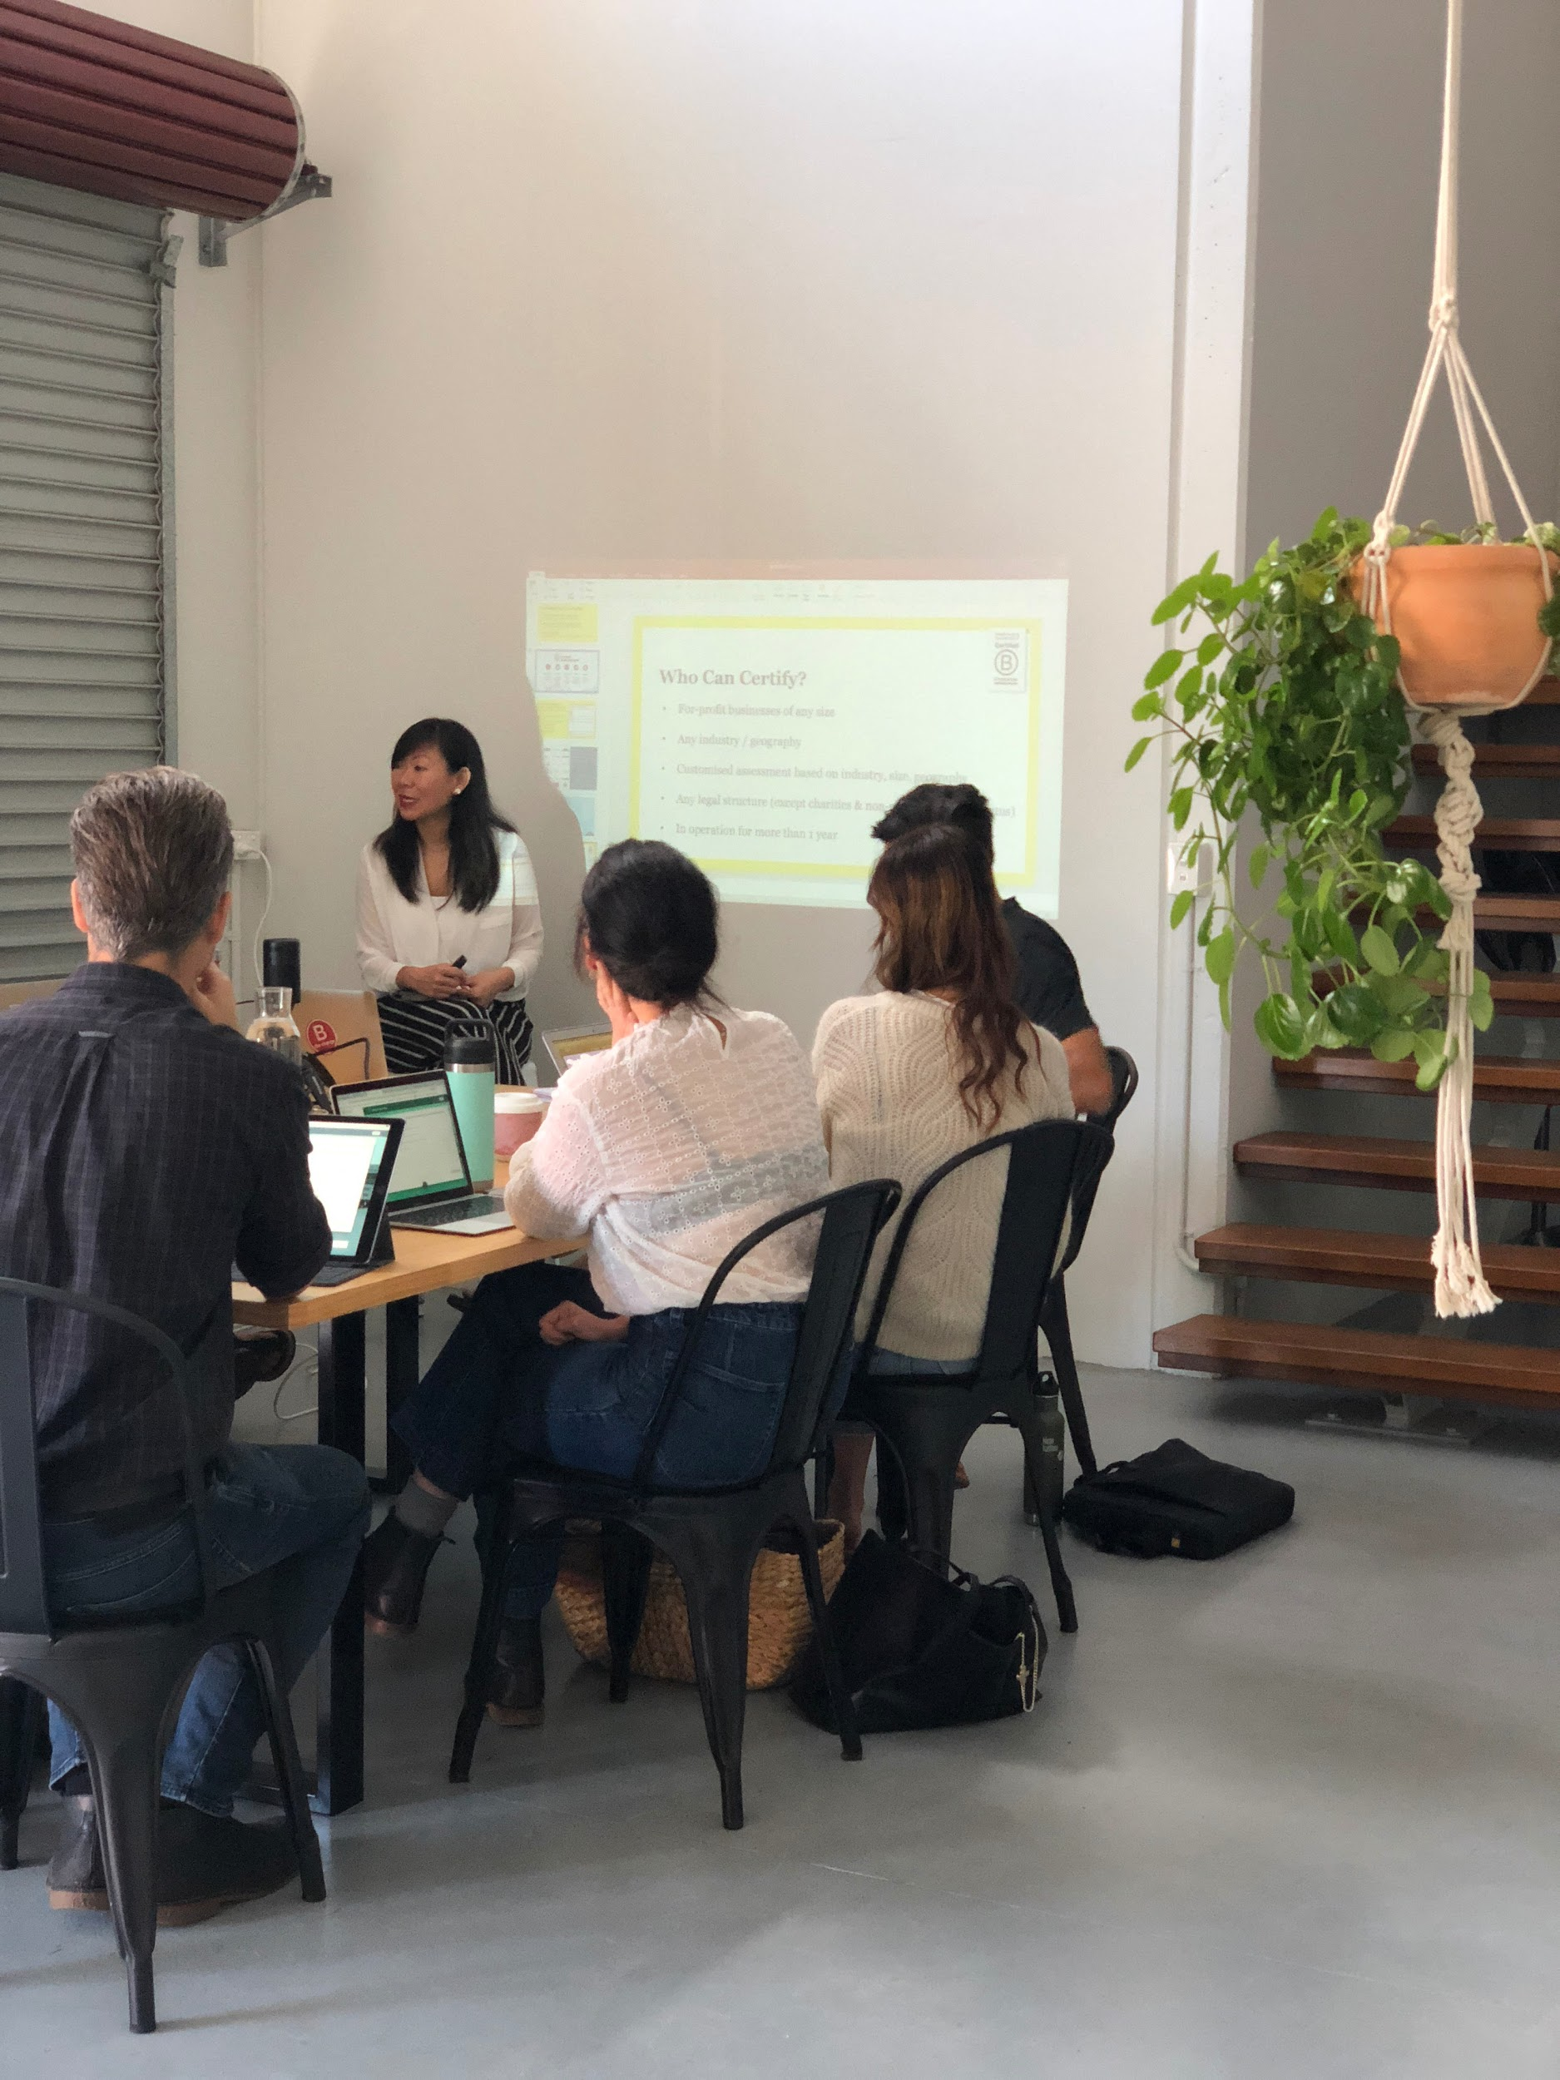
How to certify?
Meet Performance Requirement.
The first step toward Certification is completing the
B Impact Assessment.
Meet Legal Requirement.
Determine the legal requirement based on your company’s corporate form.
Make it Official.
Sign the Declaration of Interdependence, pay certification fees, and publish profile on www.bcorporation.com.au
1
2
3

Slide 17
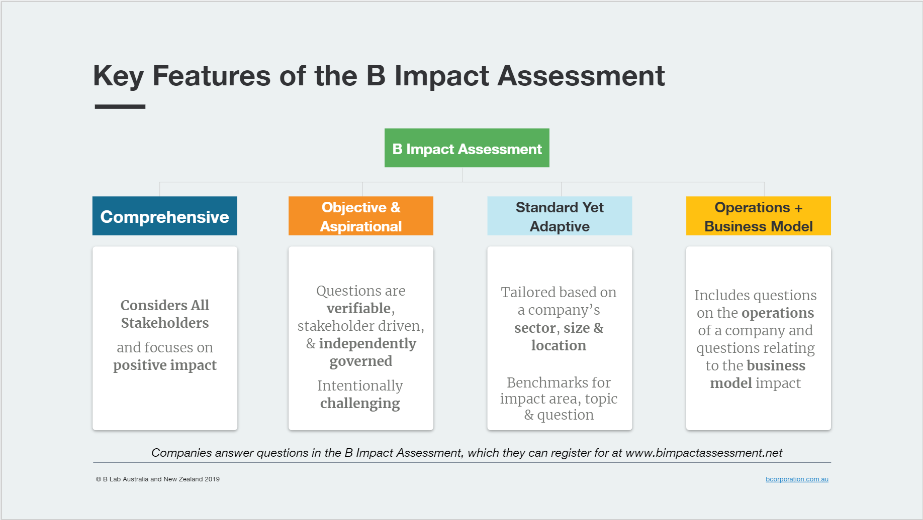
What does the BIA look at?
B Impact Assessment

Slide 18

B Impact Assessment +
Coming in 2020
B Lab will release an SDG online tool that will be integrated into the existing B Impact Assessment standards and platform. The tool will allow users to assess, compare and improve their progress on the 17 Sustainable Development Goals.
The SDG platform will feature select questions from the B Impact Assessment that have been mapped to the SDGs, supplemented by new metrics and accompanying content developed alongside the UN Global Compact and with input from stakeholders.

Slide 19
Some extra reading & resources
It pays to become a B Corporation
The Next Boom: A surprise new hope for Australia’s economy? Future Business Council
Why companies are becoming B Corps
An Entrepreneur's Guide to Certified B Corporations and Benefit Corporations

Slide 20
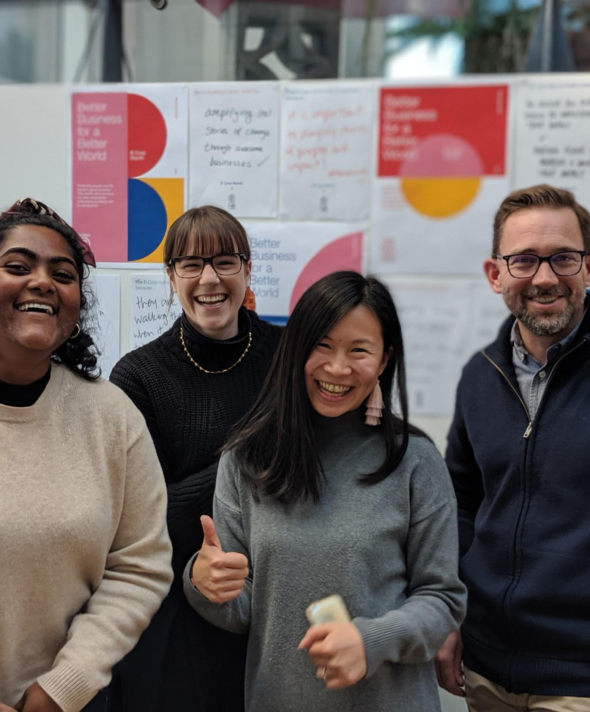

Thanks for listening
B Corp website: www.bcorporation.com.au
Take the assessment: https://bimpactassessment.net/bcorporation
Email us: frontdoor@bcorporation.com.au
Follow us:
Facebook: @BCorpANZ
Instagram: @BCorpANZ
Twitter: @BCorpANZ
LinkedIn: B Lab Australia & New Zealand
Notes:
Let’s show the world how business can be used as a force for good and grow this movement.

