Slide 1
Sustainable Finance
Ciaran O’Connor

Slide 2
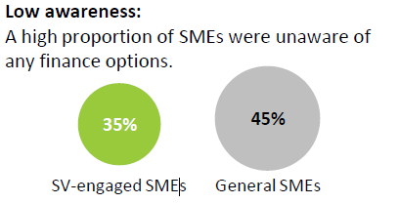
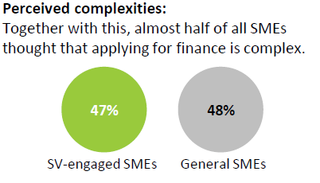
Research
Notes:
Medium proportion of SMEs not aware of specific finance available for EE opp’s
Furthermore, there is a perceived complexity around SF and applying for it.

Slide 3
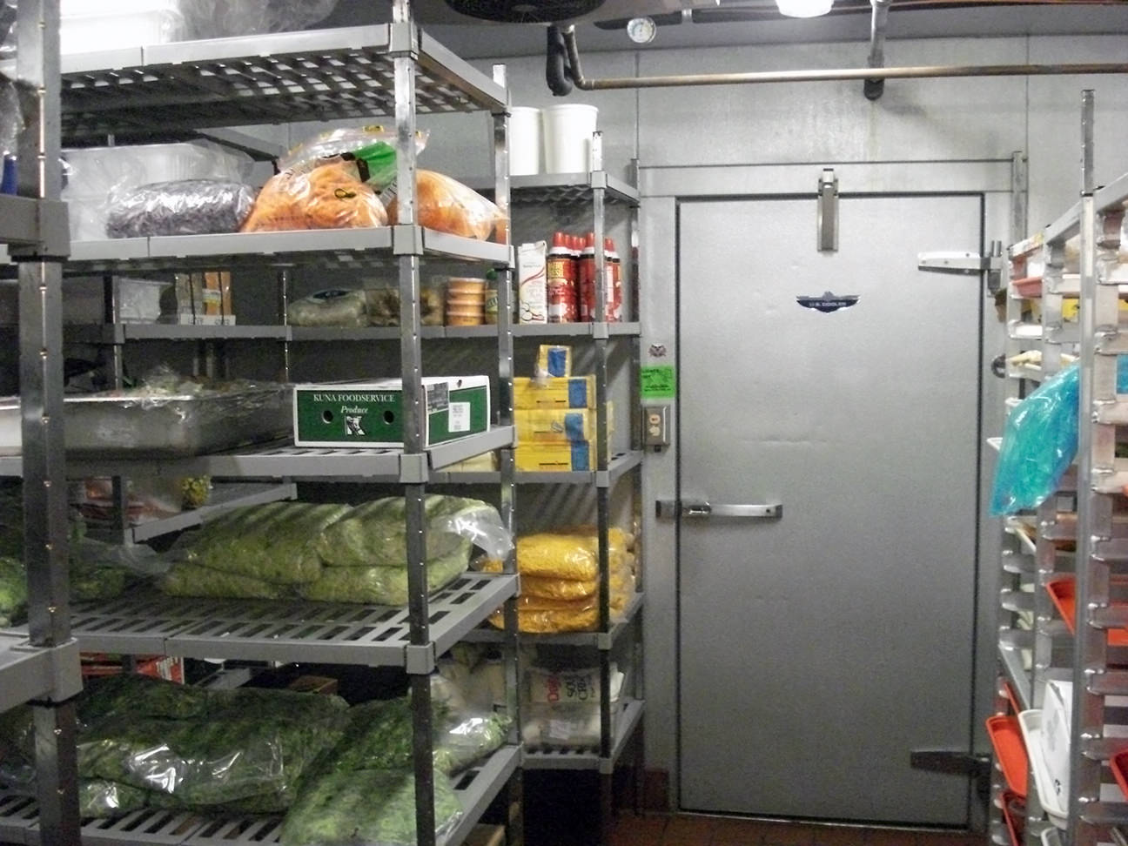
Sustainable Finance
Notes:
What is it ?
Specific financing available for energy projects provided by major banks and financiers
Projects needs to meet certain criteria :
Coolroom upgrades, lighting, HVAC, VSD, PFC etc: Solar
Traditional Finance
major banks and financiers are providing up to 0.70% discount on regular asset finance products for EE equipment
0.7 ANZ,MQ
0.5 CBA
NAB in next year

Slide 4
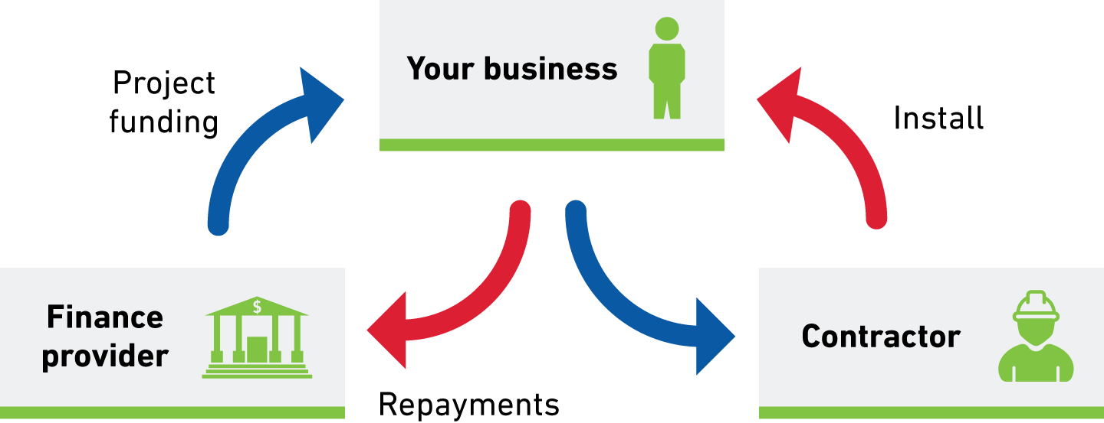
Equipment Loan (Chattel Mortgage)
Notes:
Financer lends to your business to purchase the equipment and takes a mortgage over the equipment until the loan is paid off
Tax benefit – may claim dep of assets and interest on repayments

Slide 5
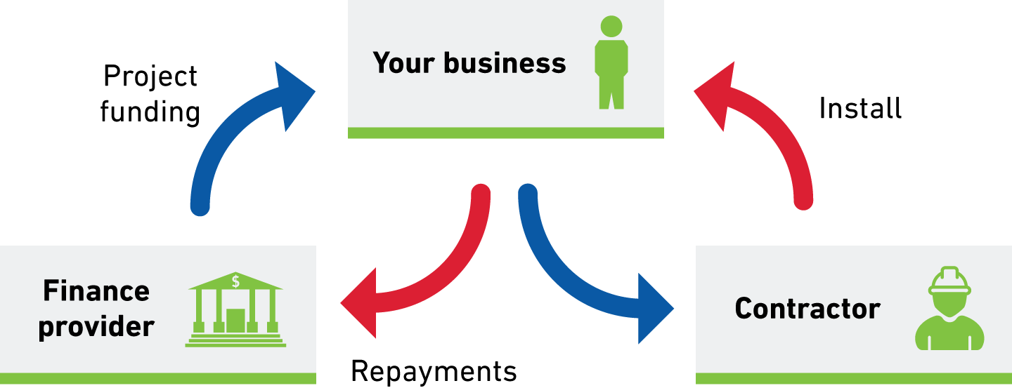
Capital Lease
Notes:
Financier purchases the equipment on your behalf which you pay for in instalments.
Business technically own the equipment and claim depreciation.
Simple process, $7500k and above

Slide 6
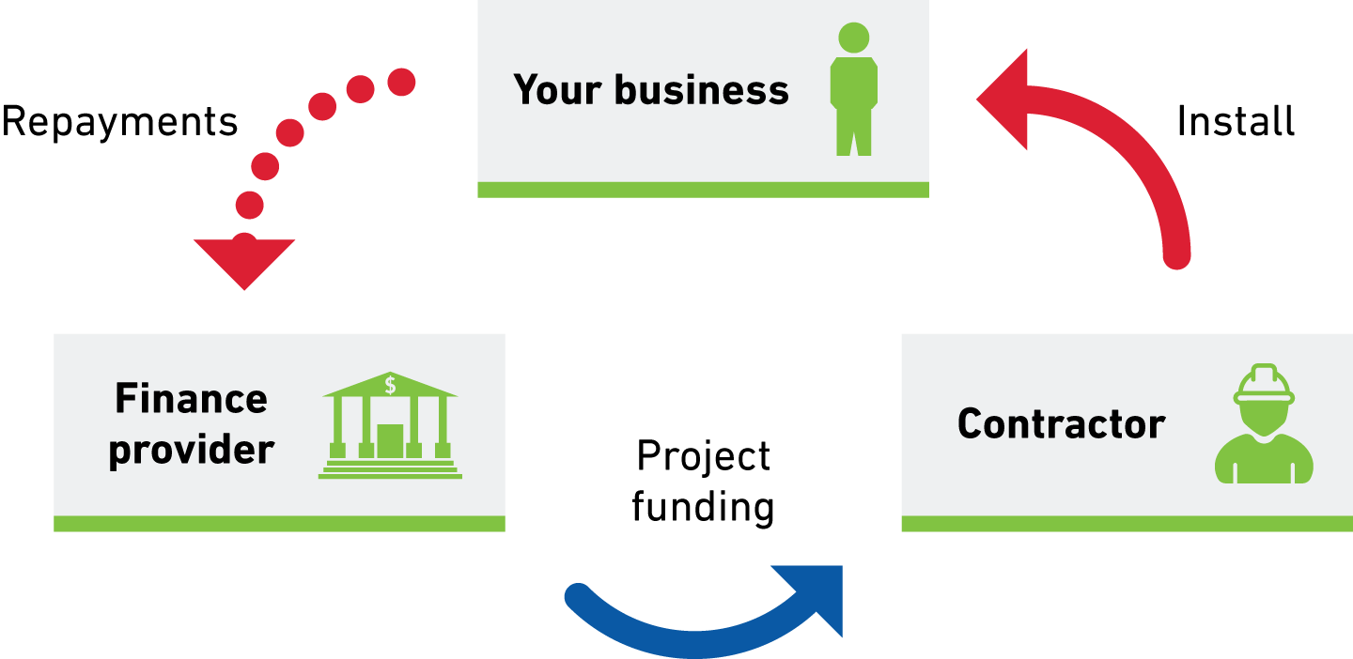
Operating Lease and Hire Purchase
Notes:
Financer purchases and owns the equipment which it then rents to you for regular instalment payments.
OL- you do not own equipment
can upgrade at end of agreement
good choice if unsure
Cannot claim tax on deprecation
HP- own at end , so can claim on dep.
Ownership is transferred after all the payments are made.
4-5% typical
For above 4 Options
Pro’s
Typically short term 1-5 years
Agreement reached within 1-3 months
Lease\Hire Purchase are good options if you don’t have building ownership and/or don’t have upfront capital
Cons
Typically on the balance sheet
Require larger projects - typically >$7500 (aggregate if under)
Need to meet credit-worthiness criteria and provide security or directors guarantee

Slide 7
Innovative Finance
Options involving a third party
Can be more bespoke
3-6 months
Longer terms

Slide 8
Environmental Upgrade Finance (EUF)
Notes:
Loan is attached to property
An agreement between a property owner, a bank and local government
Upgrade paid through additional rates
5.5% for 10 yrs typical
Pros
No upfront capital or security, no ongoing regular reporting
Positive cash flows - longer term lengths
Costs can be shared with tenants
Technically no limit to how small loan can be., $14,000 (check Council) best seen so far
Cons
Limited to participating councils
Limited to buildings
Must get an agreement with the tenant

Slide 9
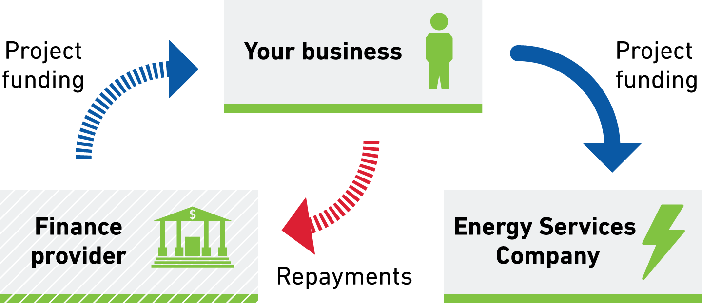
Energy Service Agreements (ESAs)
Notes:
An agreement between a business and a energy service provider ESCO
ESCO delivers energy savings to the business through various upgrades
Finance: from ESCO (5.5-6%) or financier
Pros
Can be tailored to be cash flow positive – longer terms 7yrs +
Tech can be blended to meet Business ROI
Cons
Longer term agreement both in agreement and terms.
Larger projects $250k +.

Slide 10
Behind the Meter - Power Purchase Agreements
Notes:
A rooftop solar provider installs and owns a renewable energy source on the site of the business
Electricity generated is supplied solely to the business at an agreed rate
13 cents kW/hr best currently
Pros
PM , O&M by solar provider included
Off balance sheet
Price predictability and cheaper rates
$0 upftont
Cons
No guarantee of output
Foregoing incentives
Length of contract
Business contracted for all generation inc weekends

Slide 11
Next Steps
Visit
https://www.sustainability.vic.gov.au/Business/Investment-facilitation/Sustainable-finance-for-energy-solutions
Contact
Ciaran.OConnor@sustainability.vic.gov.au
03 8626 6721
Notes:
Further detail info available at our website

